Slide 1


Slide 2
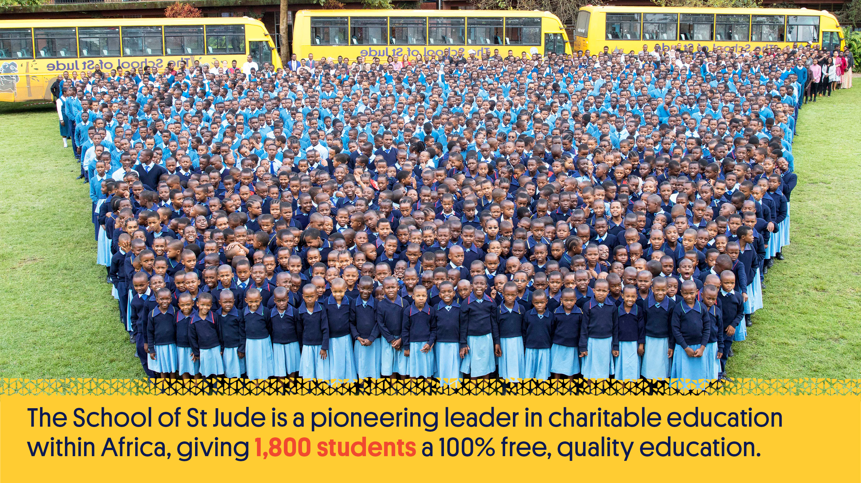
Notes:
The School of St Jude is a pioneering leader in charitable education within Africa, giving a 100% free, quality education to 1,800 of the brightest but poorest students from the Arusha region in Tanzania as well as supporting hundreds of graduates through higher education and giving 30,000+ Tanzanians quality teaching each year.

Slide 3

Notes:
St Jude’s mission is to give bright, poor Tanzanian students a 100% free, quality education; able to lead their family, community and country with respect, responsibility, honesty and kindness to growth and prosperity. The school strives for academic and moral excellence as they create community-focused leaders who challenge the status quo and find solutions to drive change for their families and the 45 million Tanzanians living in poverty. These students will one day help address the serious shortage of qualified professionals in their country.

Slide 4
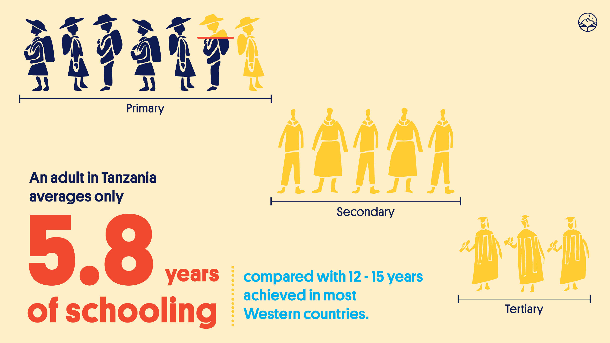
Notes:
An adult in Tanzania will have averaged less than six years of schooling compared with the 12-15 years achieved by people in most Western countries. 74% of Tanzanian students not enrolled in secondary school and 97% not enrolled in higher education.

Slide 5
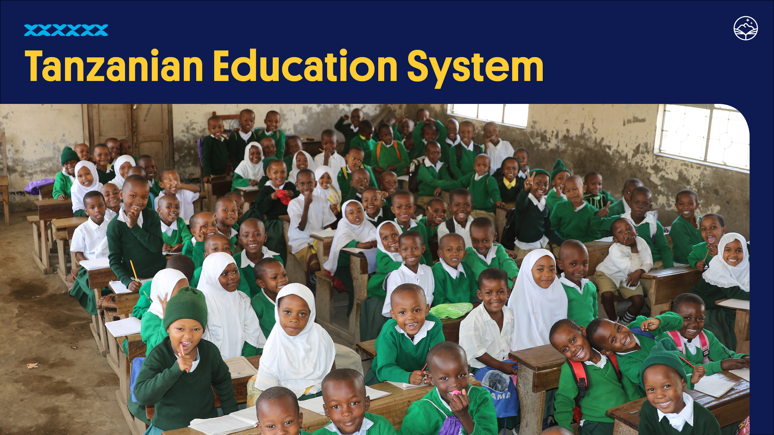
Notes:
Despite 87% of primary school aged Tanzanian children (aged 7-13) enrolling in school, the under-resourced and under-staffed education system in Tanzania means that the majority of primary school students will not pass their national primary leavers exam and won’t be eligible to continue their education. Only 3% will end up making it through to complete a tertiary education.

Slide 6
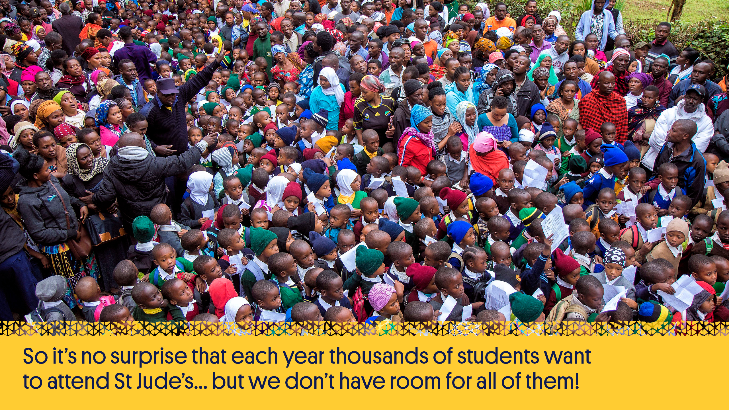
Notes:
So it’s no surprise that each year thousands of students want to attend St Jude’s but we don’t have room for all of them.

Slide 7

Notes:
Each year, over 3,000 candidates from government schools in the region are invited to attend the selection process where up to 150 places are available across Standard 1, Form 1 and Form 5.
They complete a series of tests with the youngest needing to show an enthusiasm for learning and some proficiency in Swahili, and the older students completing tests in maths, science and English.
They will have needed to have placed in the top 10% of their government school classes to be invited to the selection day.

Slide 8
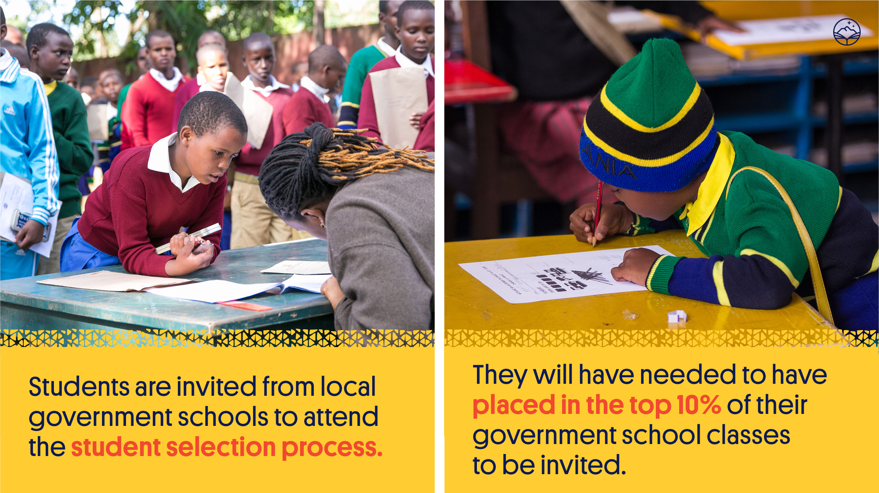

Slide 9
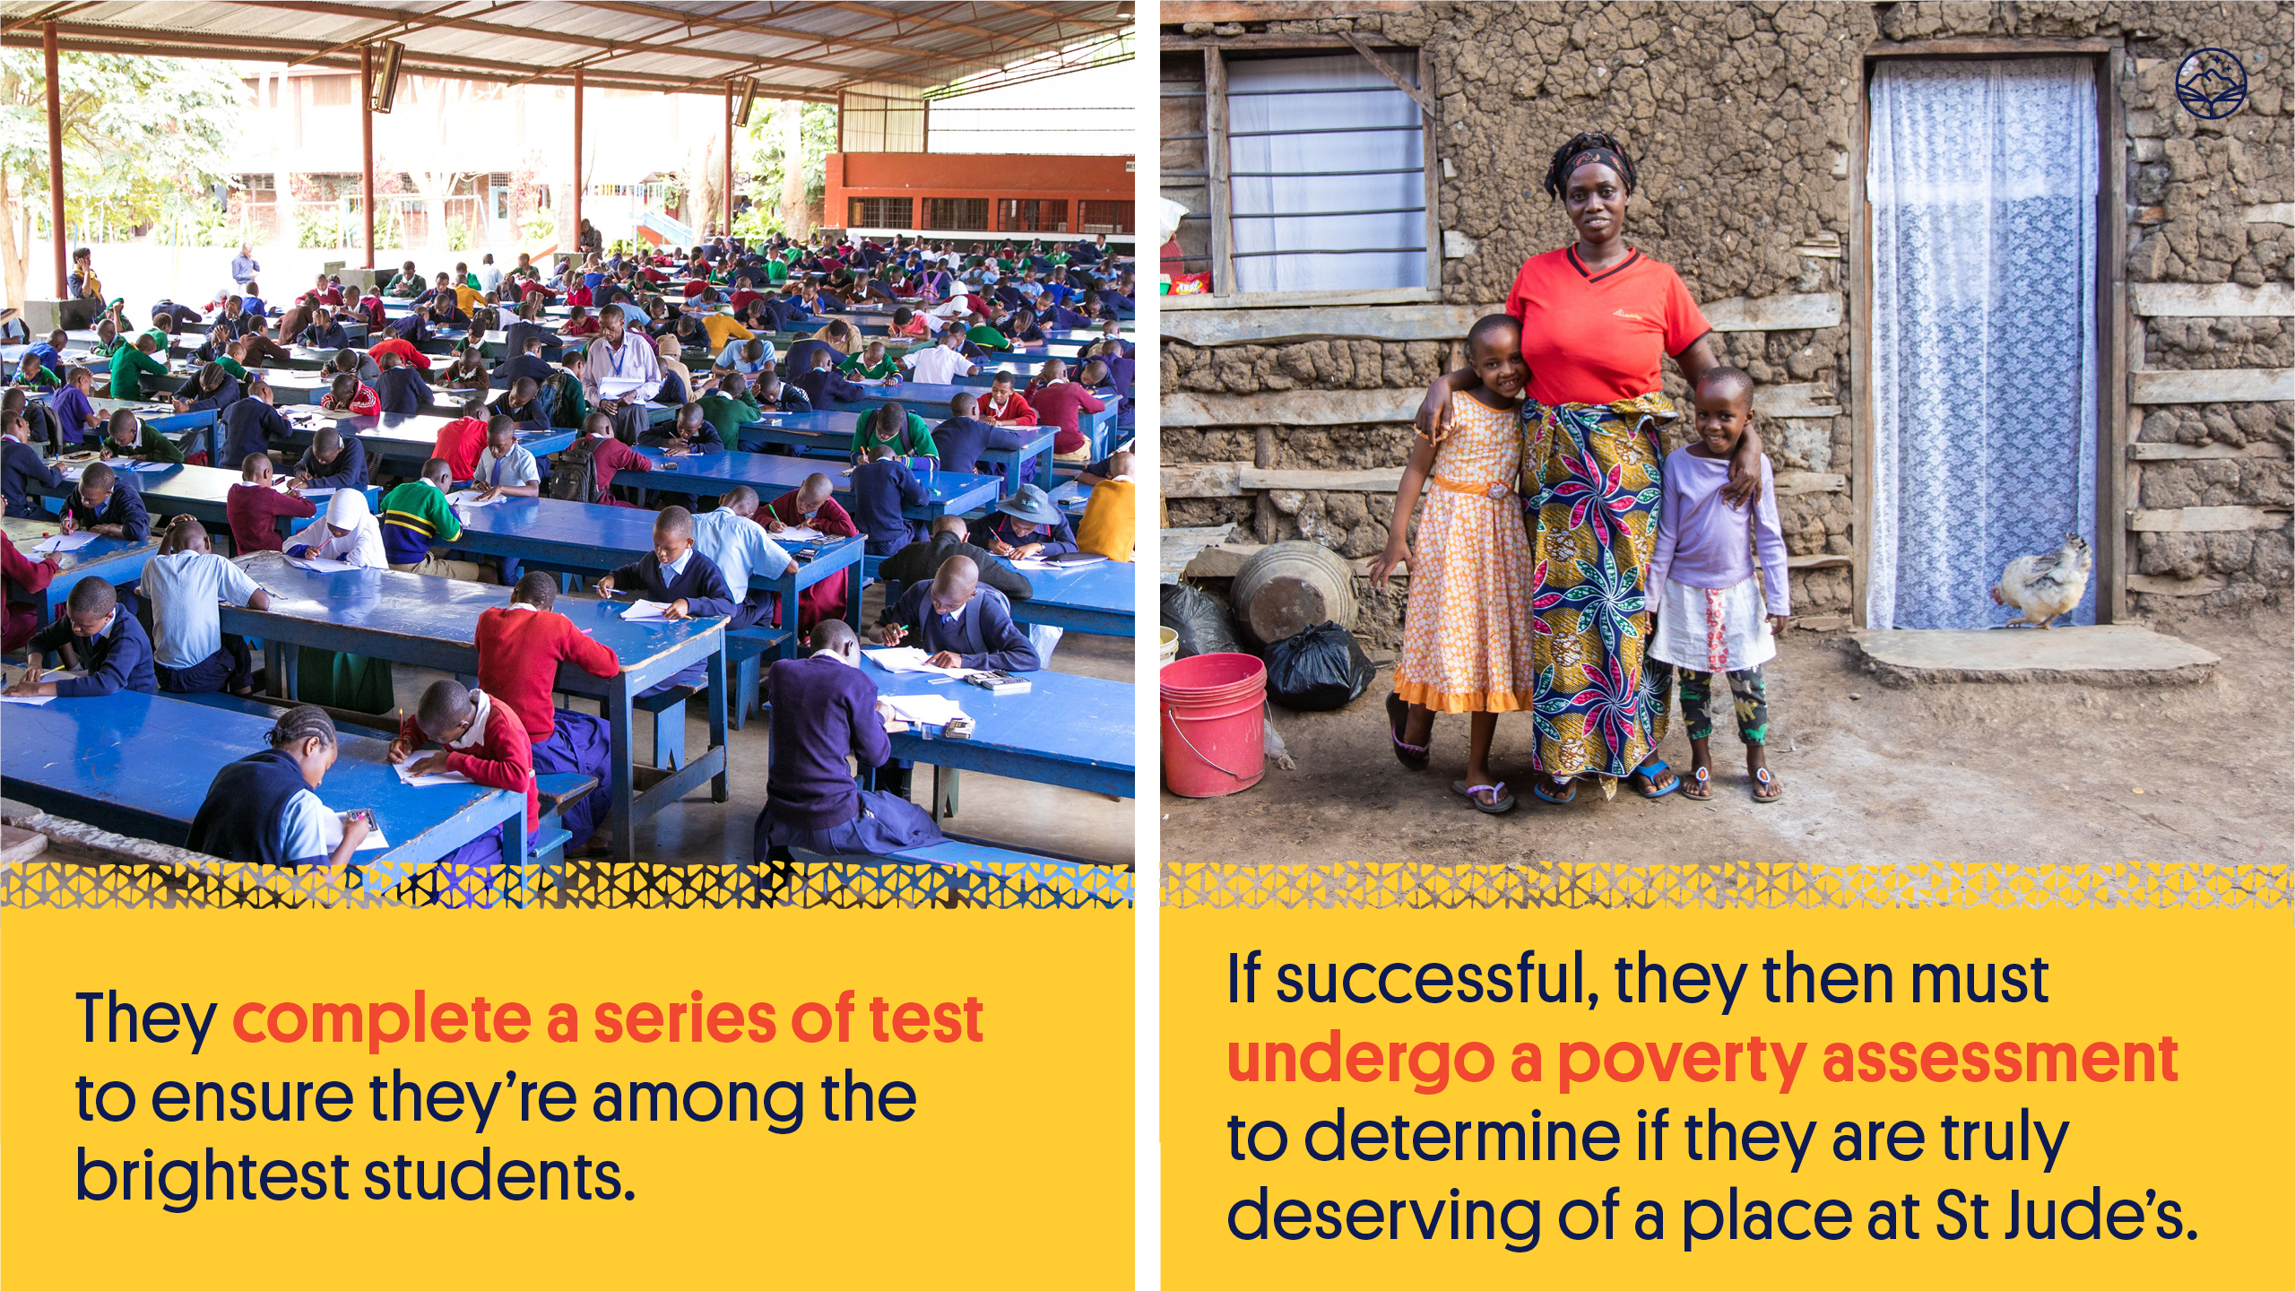

Slide 10
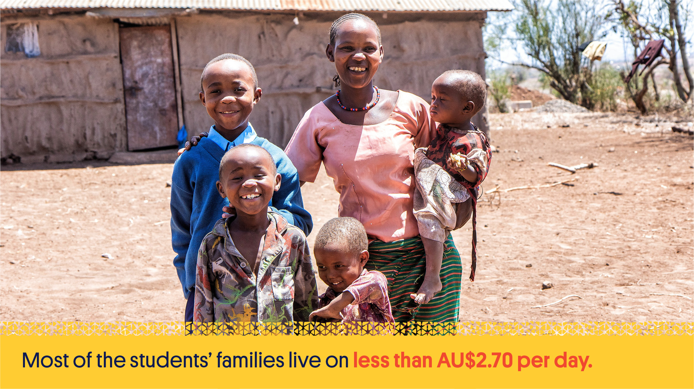
Notes:
They must also be from disadvantaged backgrounds. Every student undergoes a poverty assessment to determine their need, meaning that they are from some of the poorest families in and around the Arusha region and truly deserving of a place at St Jude’s.

Slide 11

Notes:
For the new students chosen each year, the hard work pays off on Uniform Day when they receive their brand new shirts, trousers, ties, socks, shoes and dresses. For many of them it’s the first time they’ve ever owned a new item of clothing!

Slide 12


Slide 13
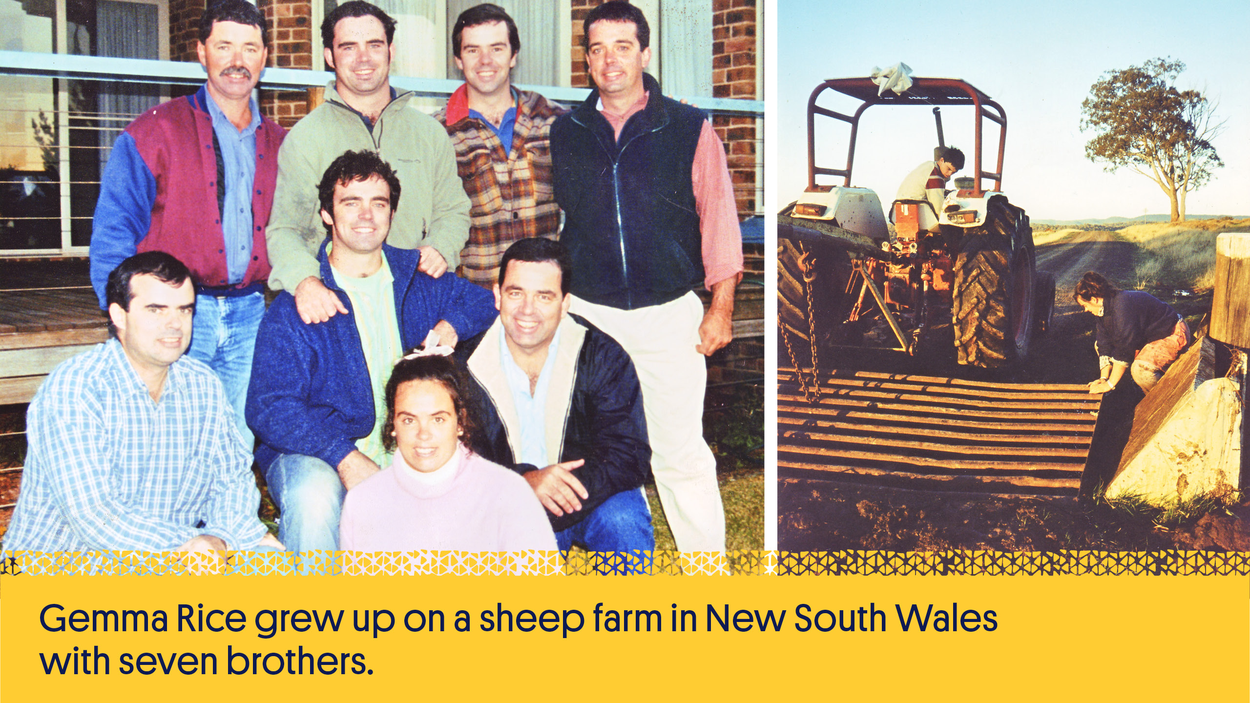
Notes:
Gemma Rice grew up on a sheep farm in northern New South Wales with seven brothers.
After finishing high school she moved to Melbourne where she completed a Science Degree (majoring in Genetics and Biochemistry).
She then went on to complete her Honours in Science before also earning a Diploma of Education.

Slide 14
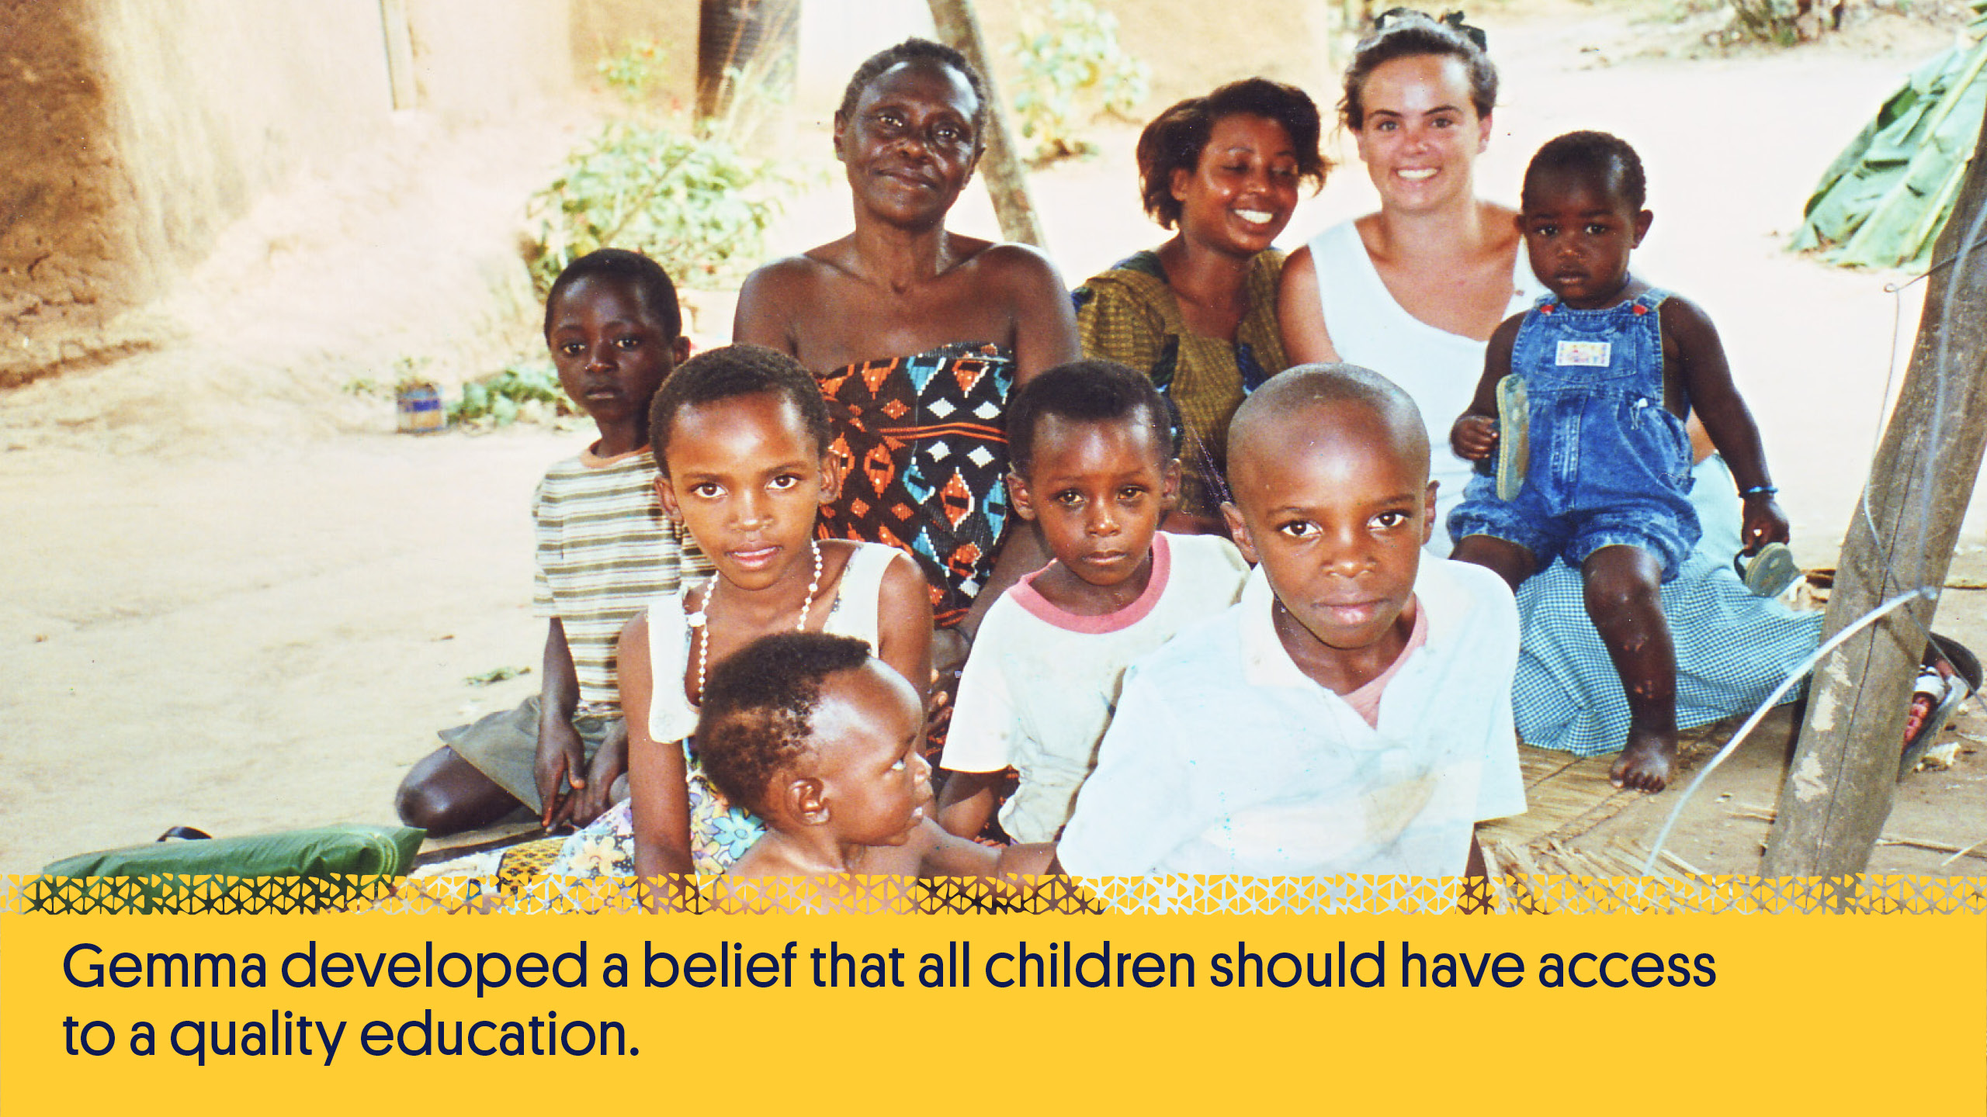
Notes:
When she was 22, Gemma travelled to Uganda to teach. There she developed her belief that all children should have access to a quality education, the key to breaking the intergenerational poverty cycle, and be able to live a life rich with knowledge, love, compassion and opportunity.

Slide 15
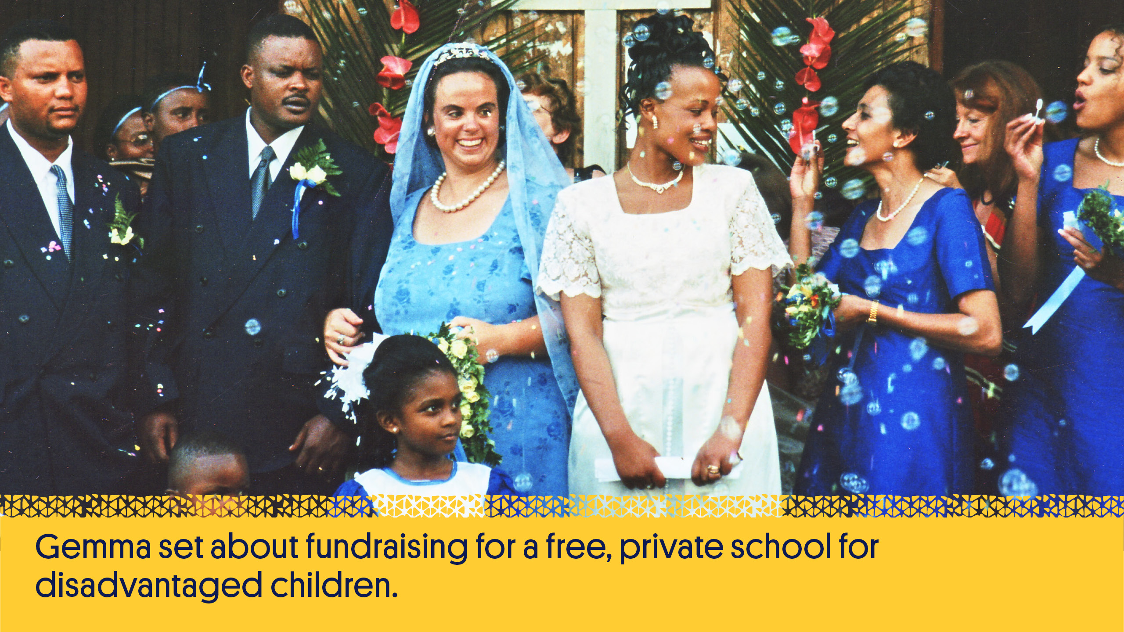
Notes:
After falling in love with and marrying Richard Sisia, a Tanzanian safari guide, Gemma decided to set up her school in Moshono, Arusha on a plot of land donated by Richard’s father, who believed she could make her vision a reality right there in his village.

Slide 16
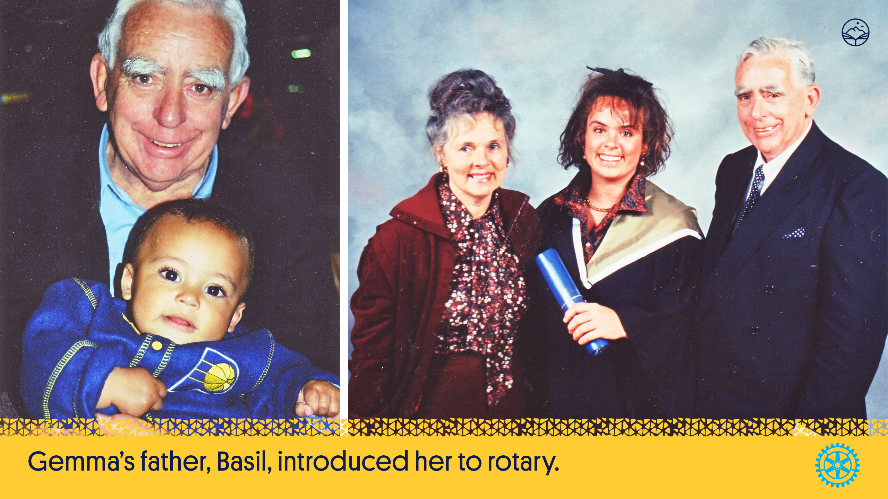
Notes:
After Gemma’s father, Basil, introduced her to Rotary she was given the opportunity to speak to her local Rotary club in her hometown of Armidale, New South Wales.
With the help of the Armidale, Tamworth and Inverell Rotary and Inner Wheel clubs, Gemma was able to raise $20,000 to get the School started.

Slide 17
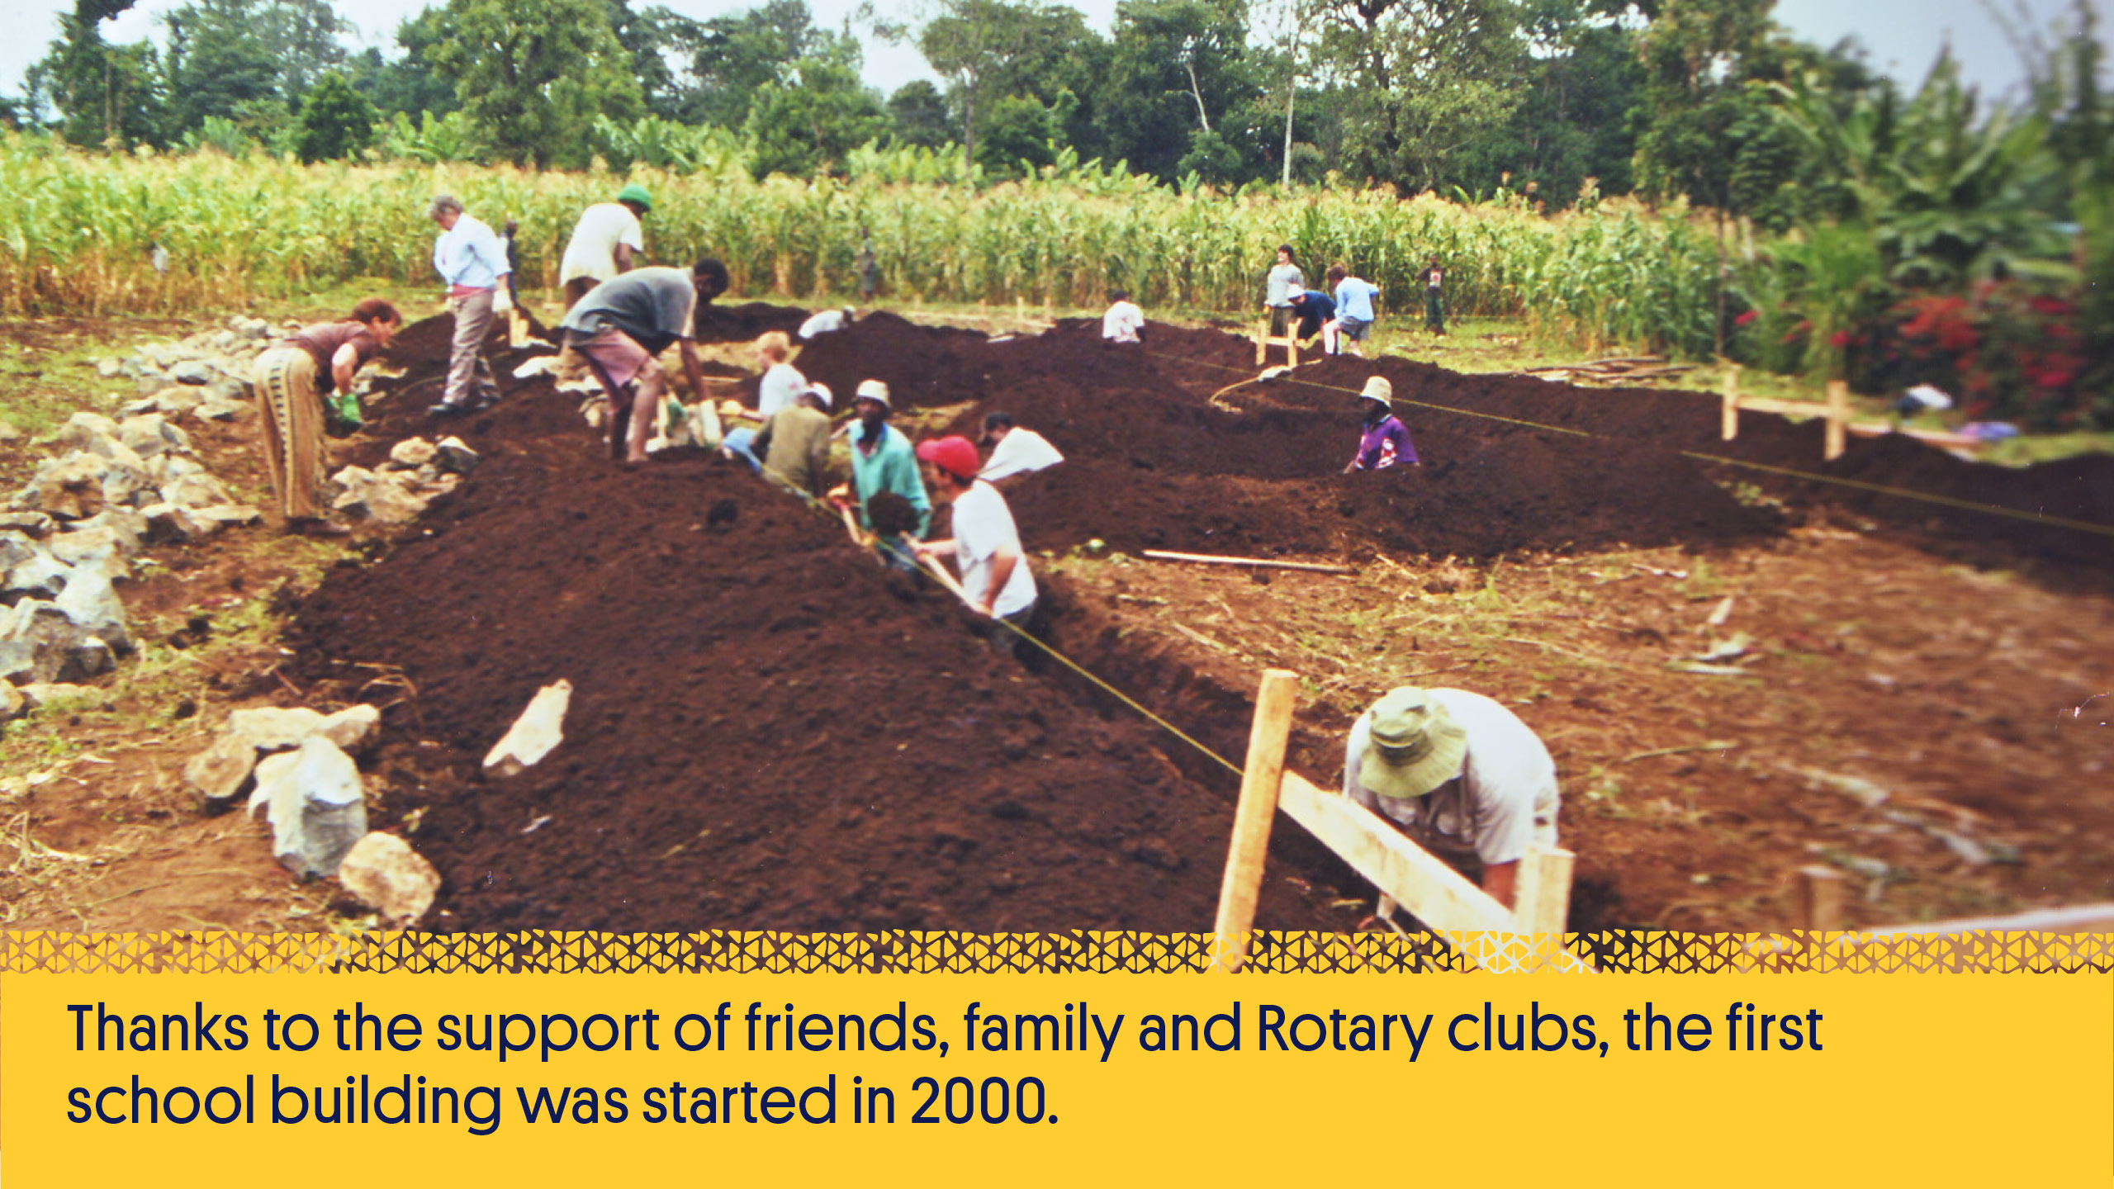
Notes:
With her first donation of just $10 from a friend, Gemma set about fundraising and began to create a free, private school for disadvantaged children.
Thanks to the support of friends, family and Rotary clubs, the first school building was started in 2000.
The Armidale Central Rotary Club organised a team of a dozen volunteers to travel to Arusha and help build the first six classrooms. A team then came from Gosford North Rotary Club and helped to build the second classroom block.

Slide 18
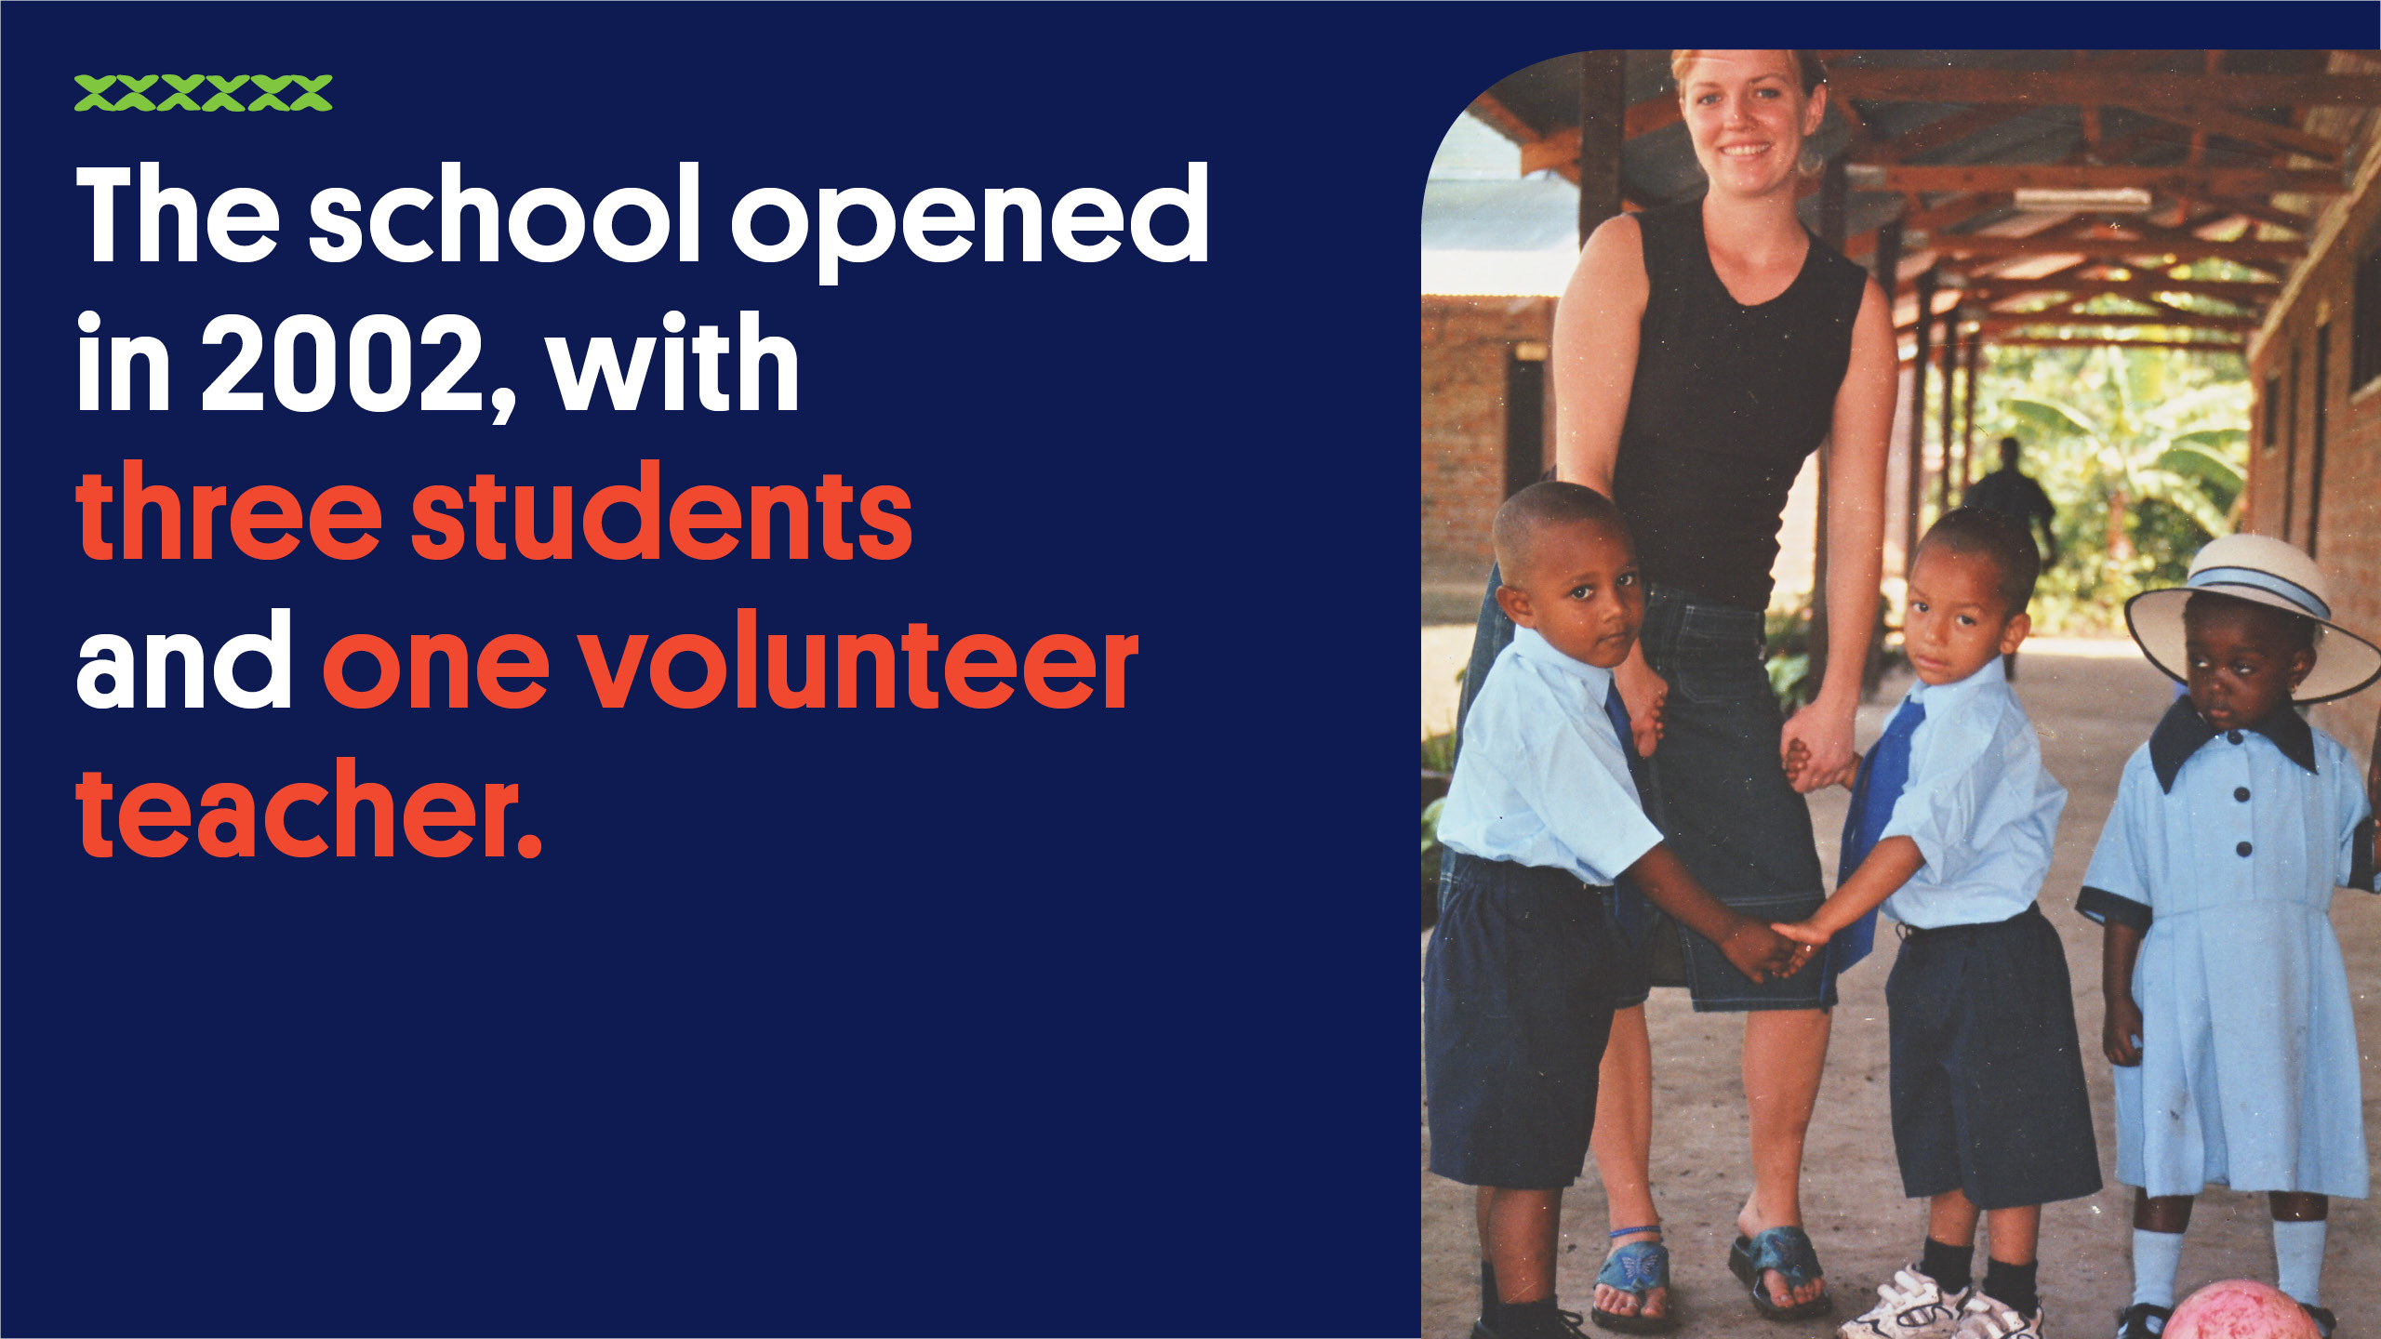
Notes:
Gemma chose the school’s name knowing that to try and start a school with a single $10 donation was surely a hopeless cause and that to make it happen, she would need all the help she could get – including from her old friend St Jude, the patron saint of hopeless and impossible causes. In 2002 when the school gates opened, she had only secured sponsors for three children, so that’s where they started.

Slide 19
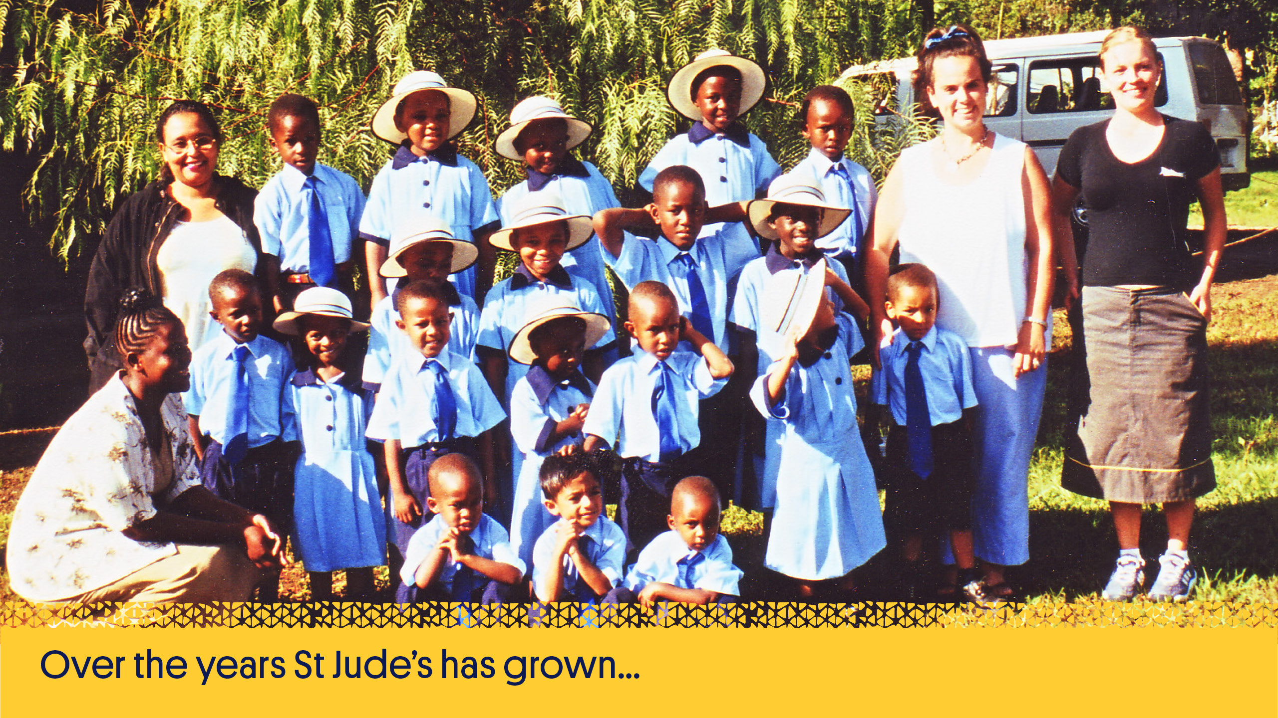
Notes:
But she worked hard to secure more sponsorships so that she could bring the opportunity to more students.

Slide 20
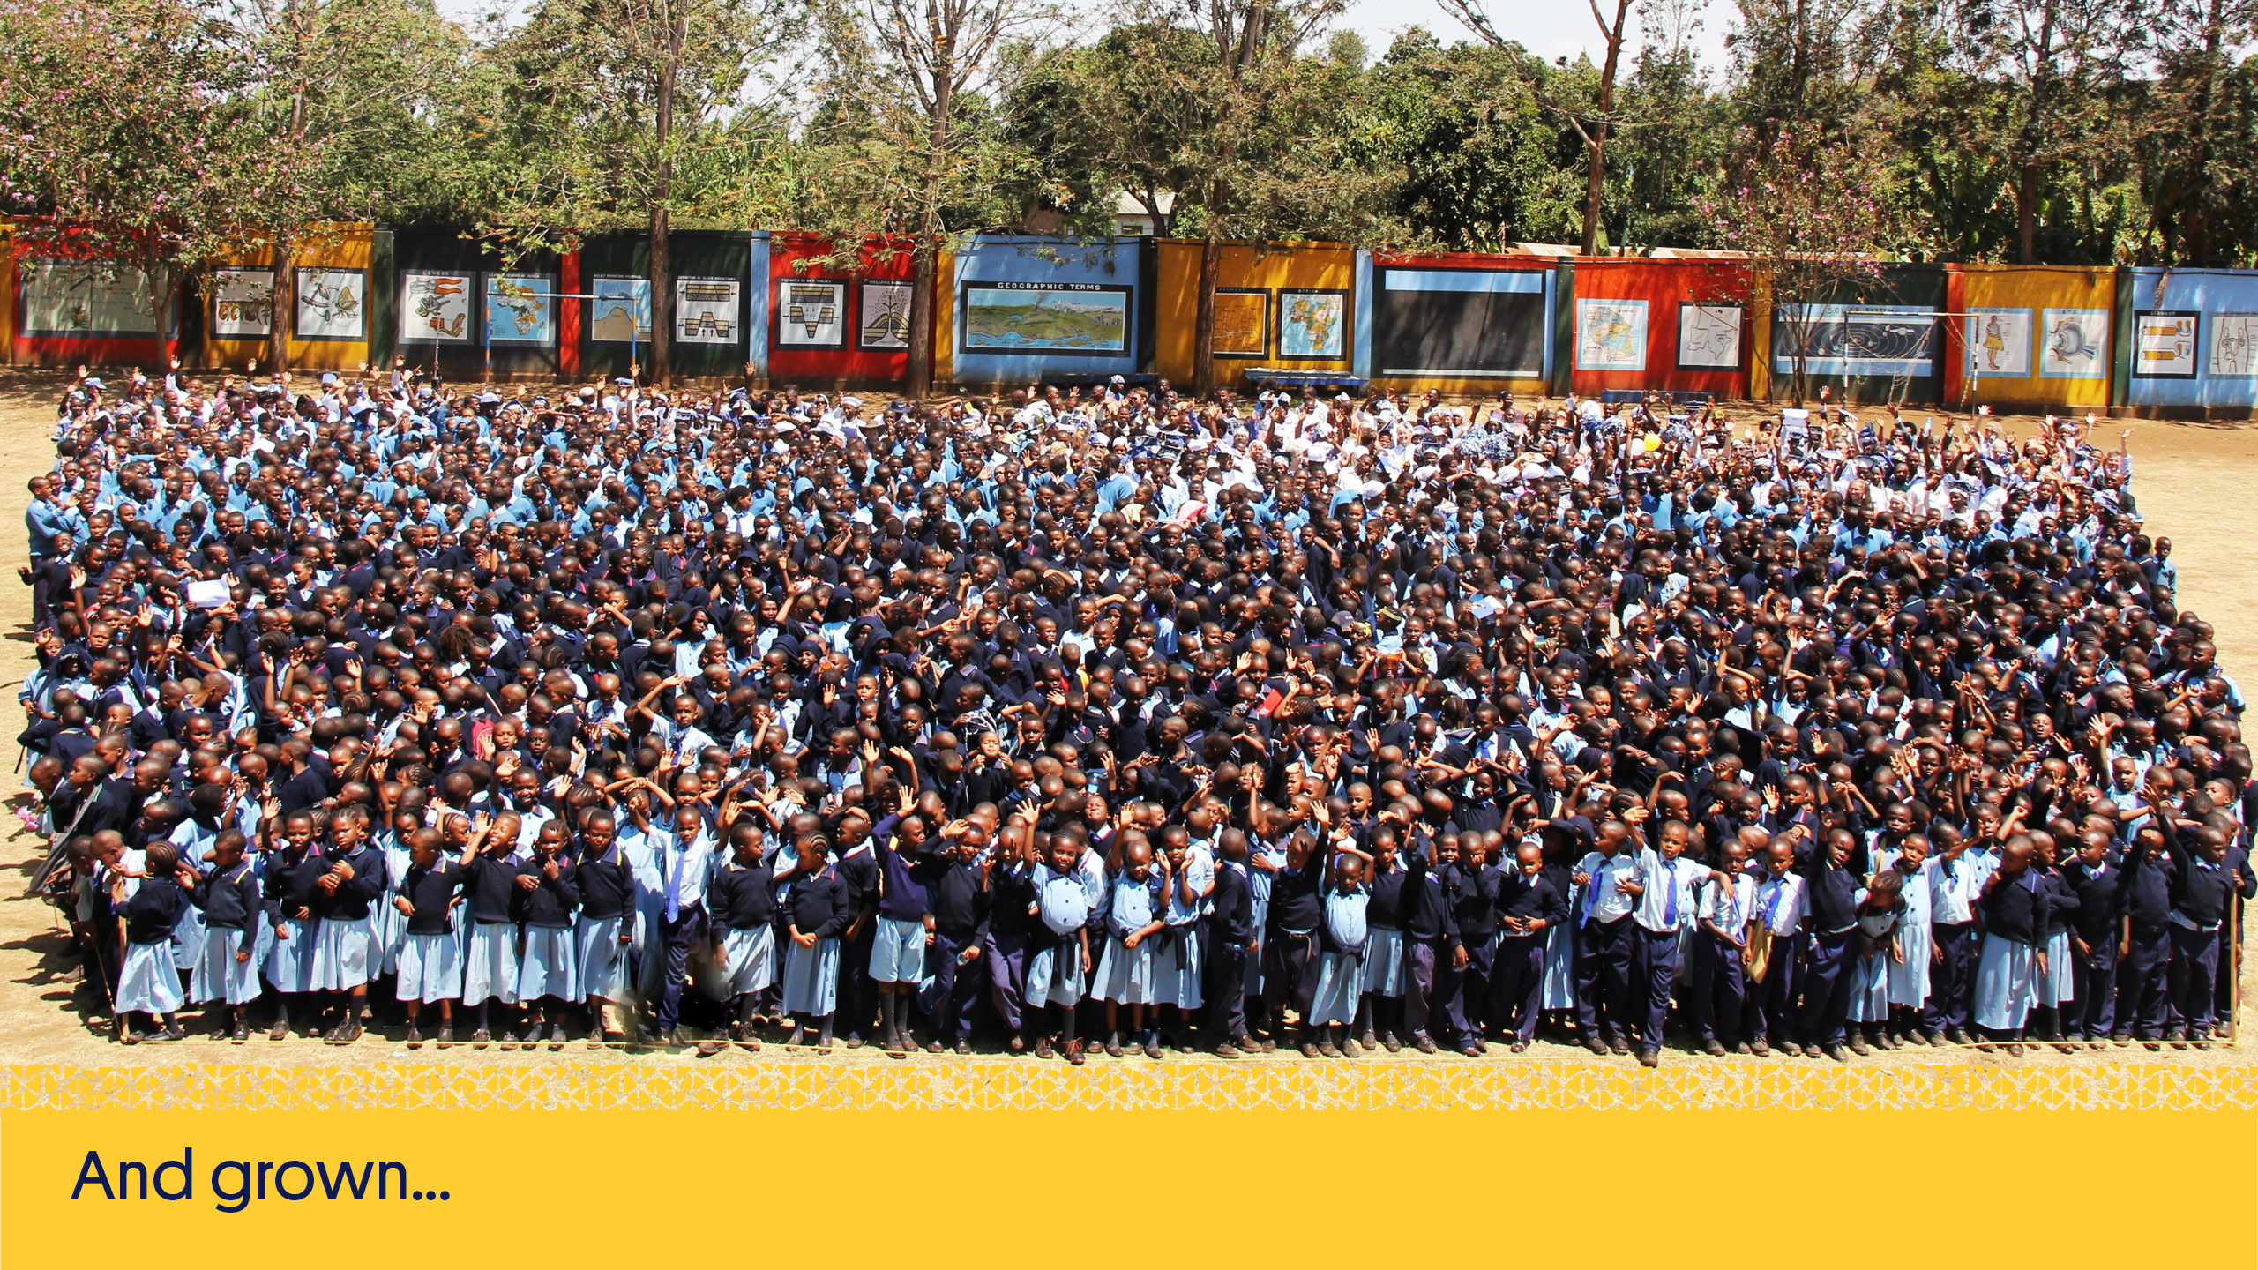

Slide 21
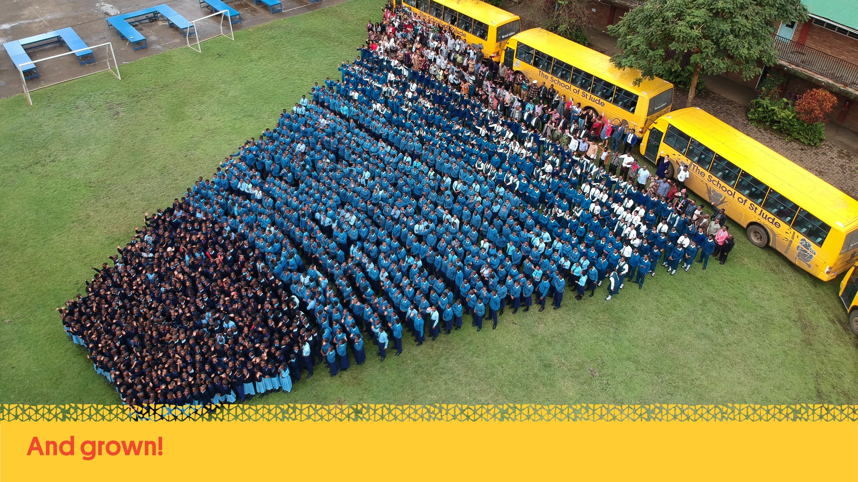

Slide 22
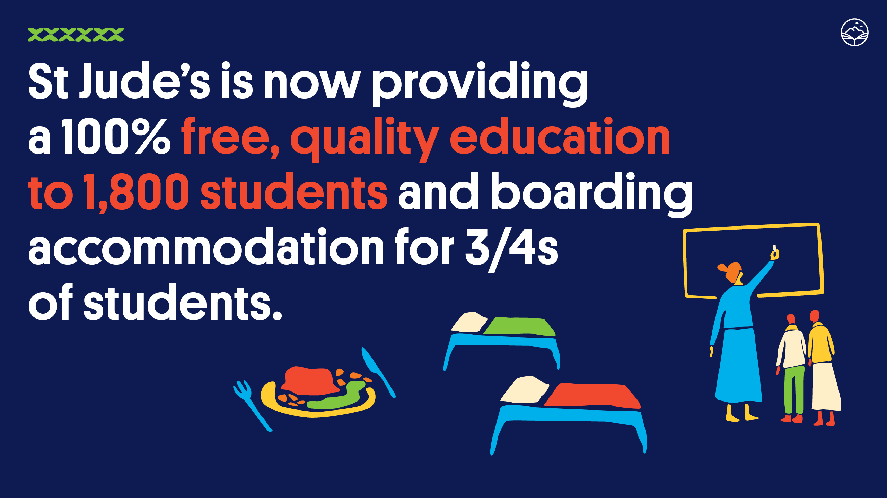
Notes:
In 2019, St Jude’s is providing a 100% free, quality education to 1,800 students and boarding accommodation for 3/4s of students as well as providing more than 1 million meals each year for its students and staff! The school employs more than 270 local staff, including academic and business leaders and all of the teachers are Tanzanian.

Slide 23
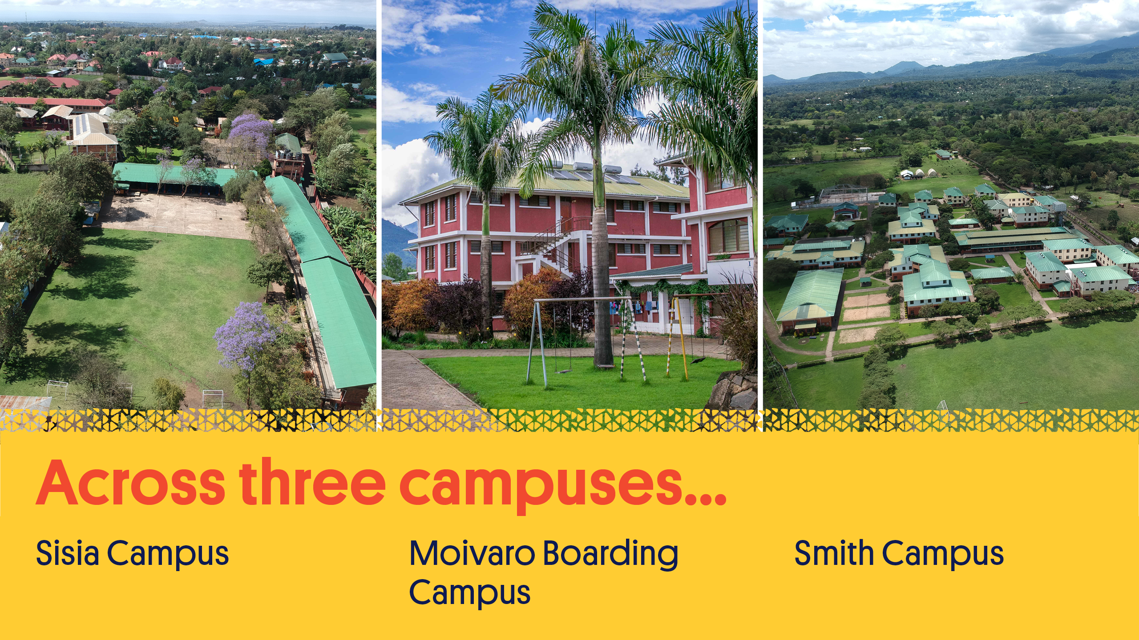
Notes:
St Jude’s is spread across three campuses;
Sisia Campus - educating Standard 1 to Standard 7 and home to our business administration office. It is also where we opened St Jude’s Girls’ Secondary School, providing education for girls from Form 1 to Form 4.
Moivaro Boarding Campus – providing boarding to Standard 6 & 7 throughout the school week and also boarding for the new girls’ secondary school students
Smith Secondary Campus - educating O Level Boys and all A Level students’ as well as providing boarding accommodation

Slide 24

Notes:
In January 2020, St Jude’s took a bold next step and opened a new secondary school for girls – St Jude’s Girls’ Secondary School, that will educate up to 600 girls from Form 1 to Form 4.
A new secondary school for girls means more girls able to compete in the workforce, more graduates accessing higher education and future generations with a role model and mentor to ensure they reach their potential too. Educated women ensure their children are educated, healthy and are empowered to change the world.

Slide 25
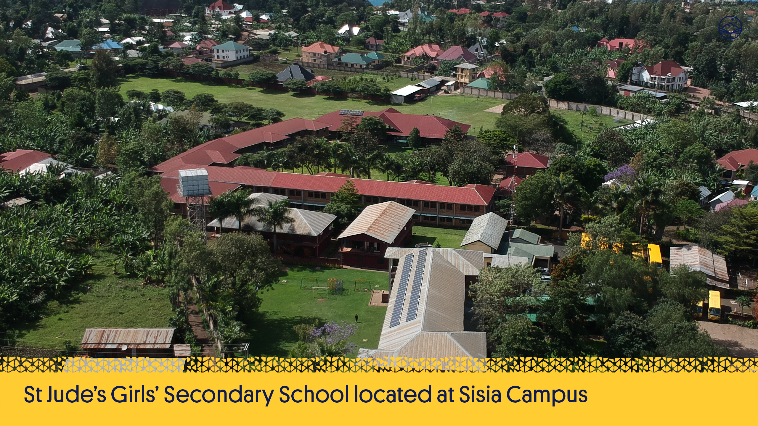

Slide 26
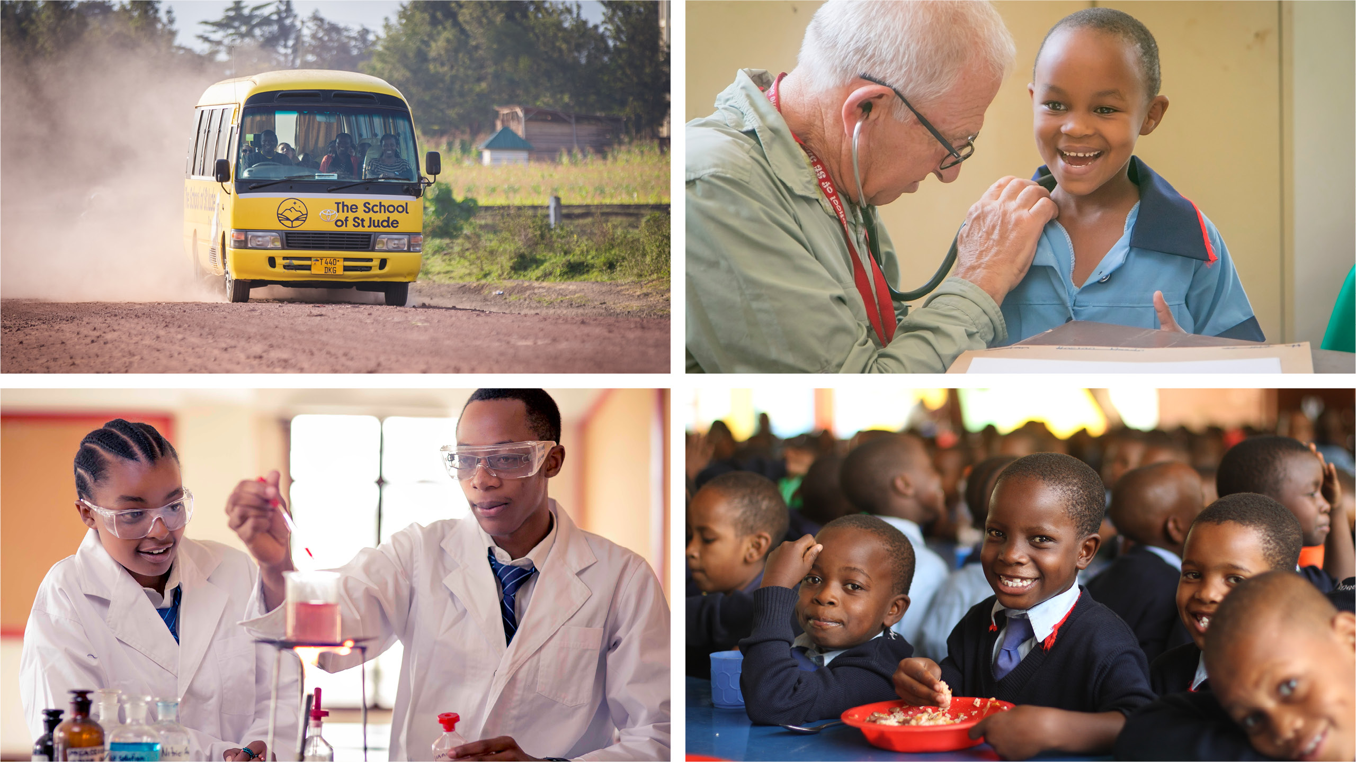
Notes:
The students are taught an extended national curriculum and have access to science and computer labs and libraries. The school prioritises nutrition with nourishing daily meals and clean water, optimises health with checks by international medical volunteers and provides transport to maximise attendance for those not yet old enough to board.

Slide 27
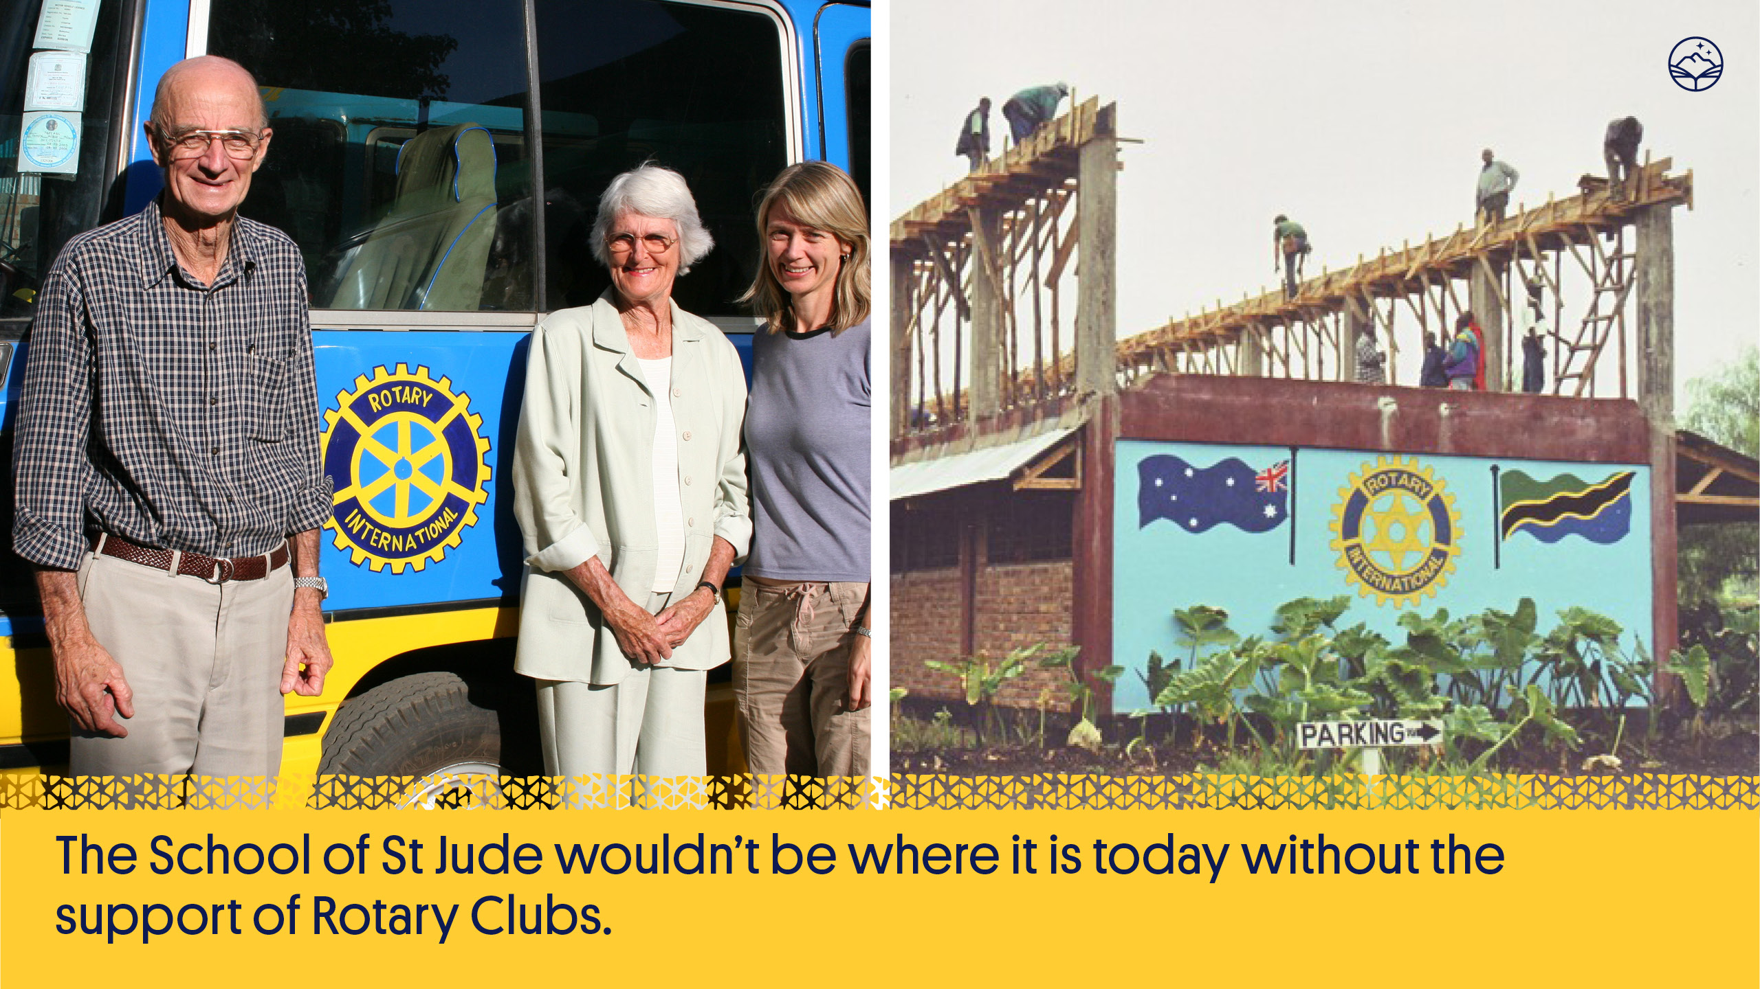
Notes:
The School of St Jude wouldn’t be where it is today without the support of Rotary Clubs.
It continues to work with Rotary and is dedicated to producing community members who hold the same values as Rotarians.
Over 17 years 283 Rotary Clubs have helped to raise over three million dollars for the school.

Slide 28

Notes:
Rotary continues to support The School of St Jude. Every year Gemma attends various Rotary District Conferences all over the world from Australia and New Zealand to America. Rotary helped build the school’s first classroom, stock their libraries, purchase buses and support the teachers. It has sponsored students and shared the St Jude’s story with thousands of others to raise awareness.

Slide 29
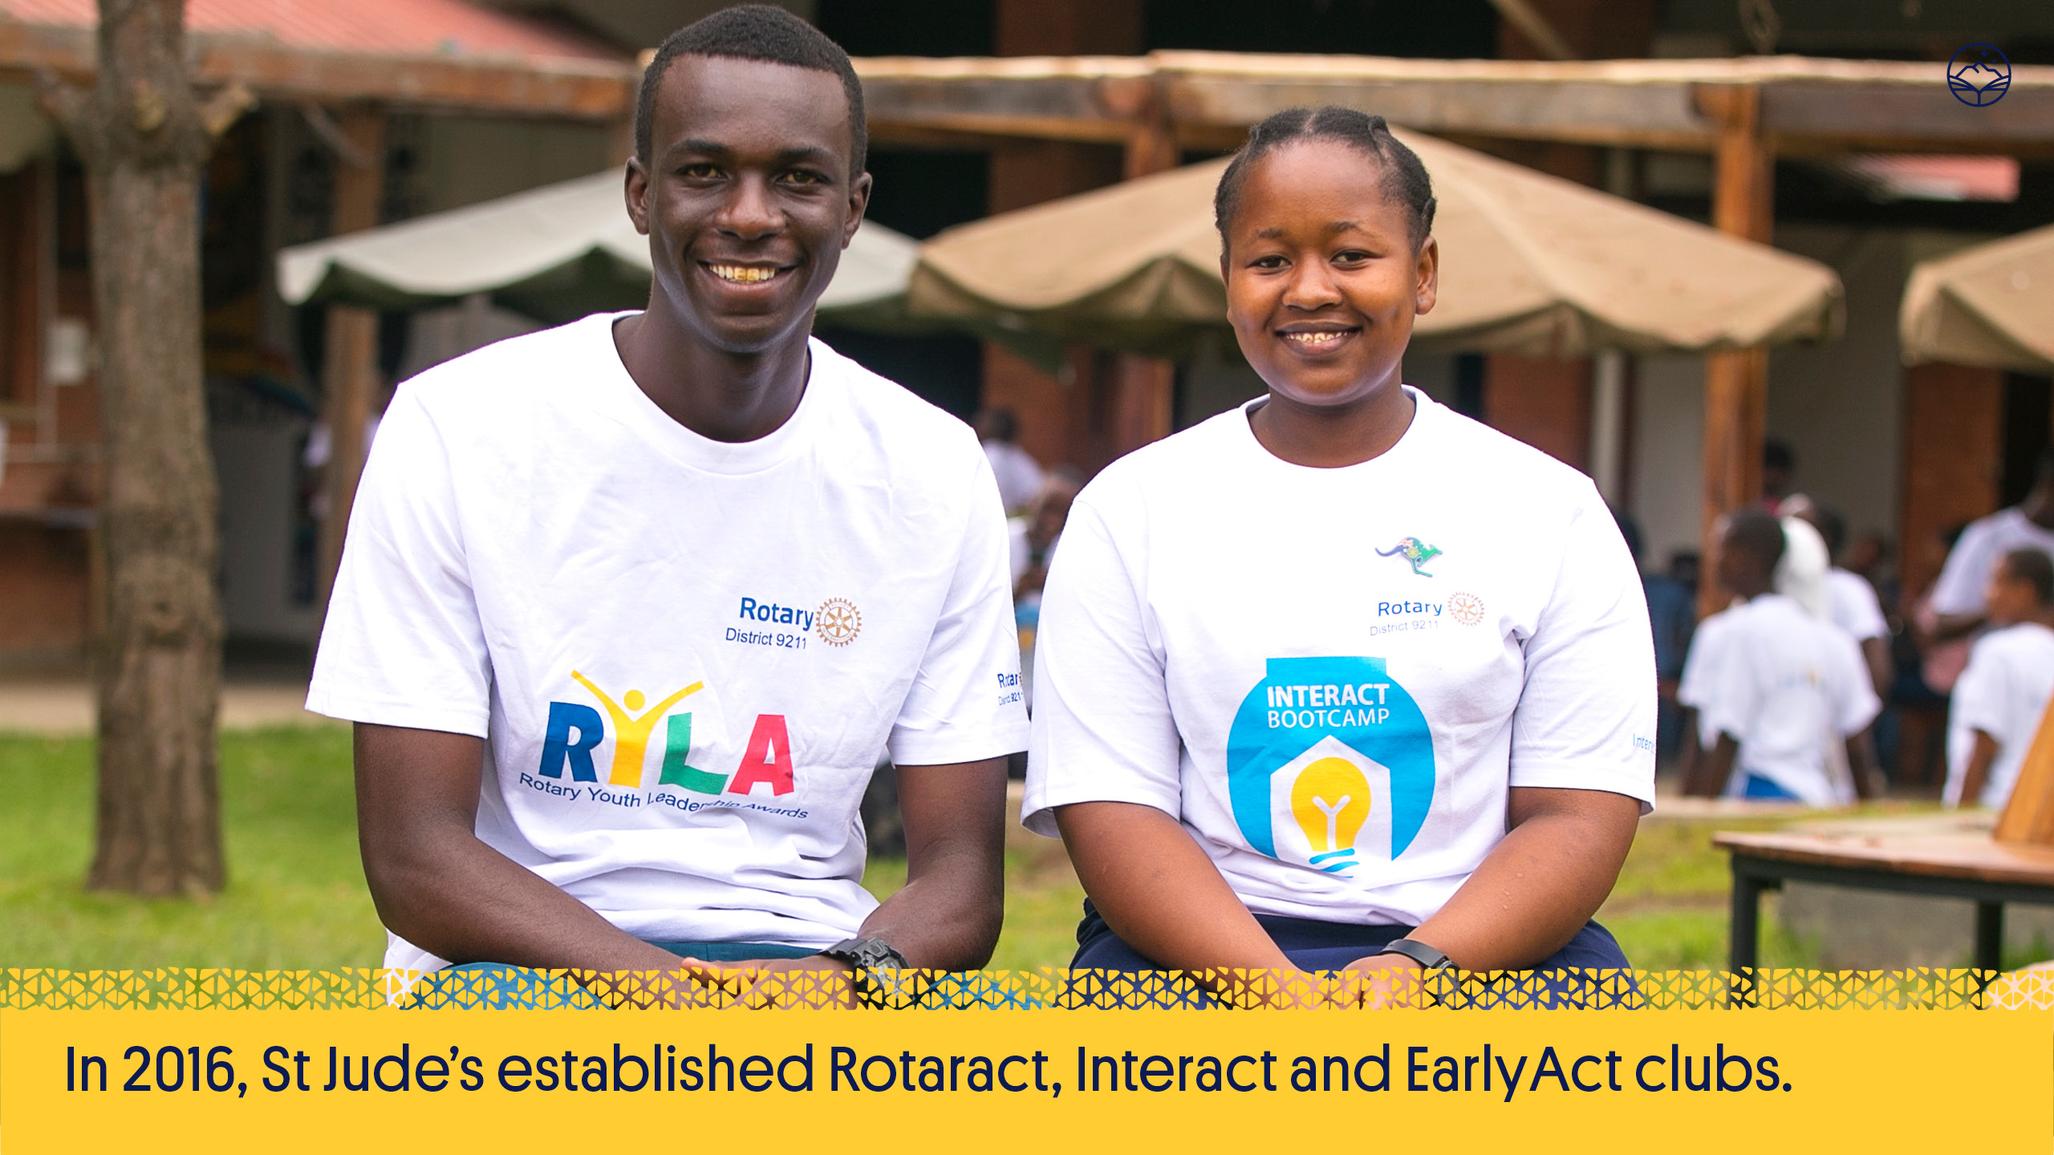
Notes:
We are proud to say that the value of Rotary has also been realised by our students.
In 2016, St Jude’s established Rotaract, Interact and EarlyAct clubs.

Slide 30
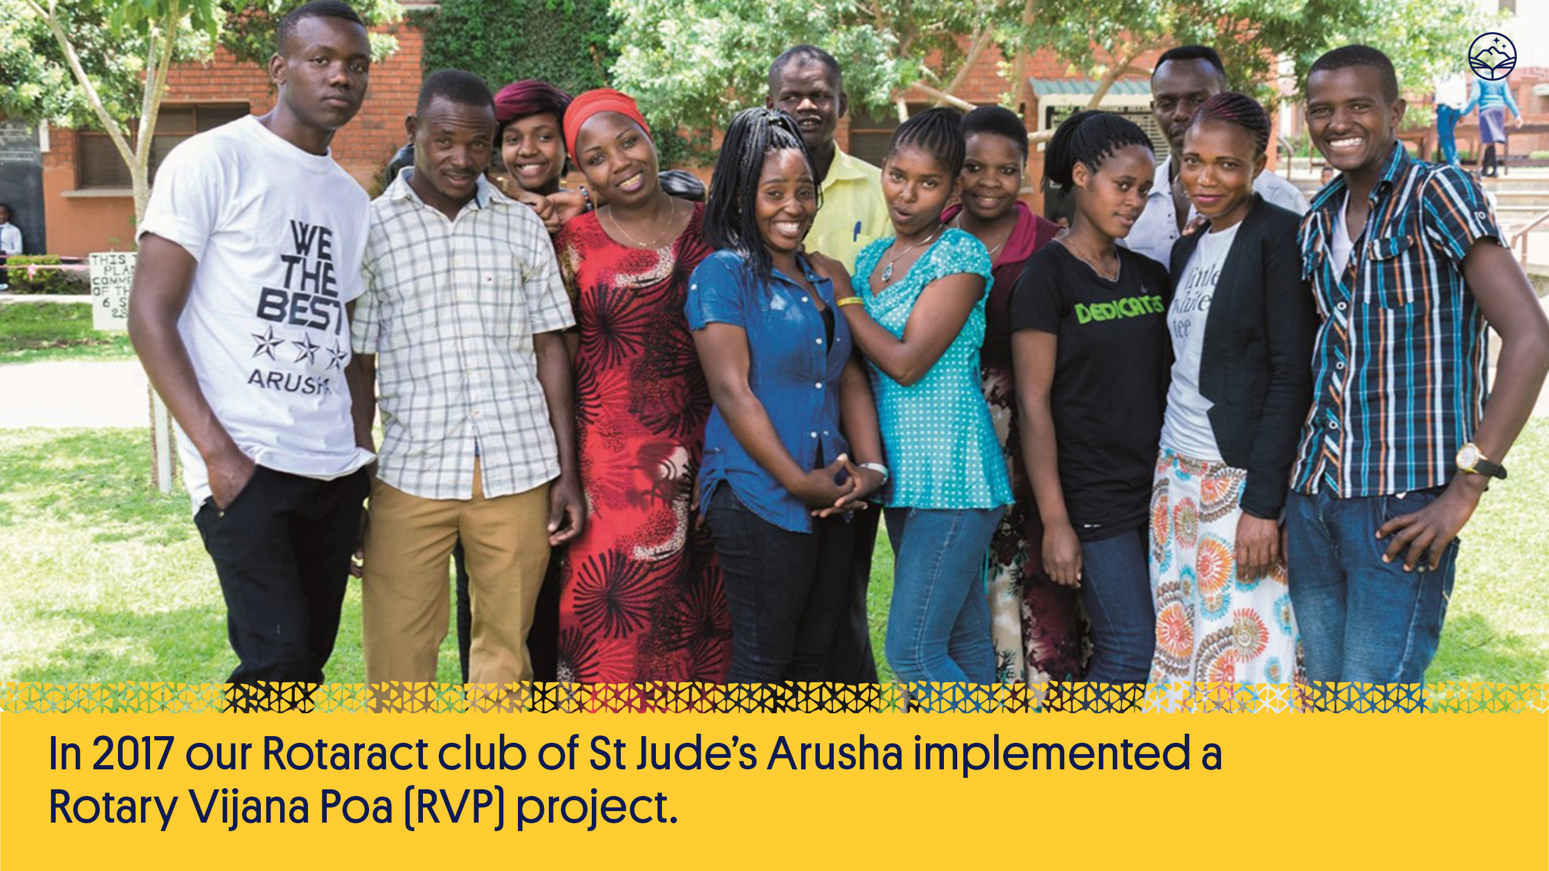
Notes:
In 2017 our Rotaract Club of St Jude’s Arusha implemented a Rotary Vijana Poa (RVP) project to help 12 individuals escape the cycle of poverty caused by youth unemployment. All participants successfully completed a 5 week training workshop with 60% gaining employment or starting their own business after.

Slide 31
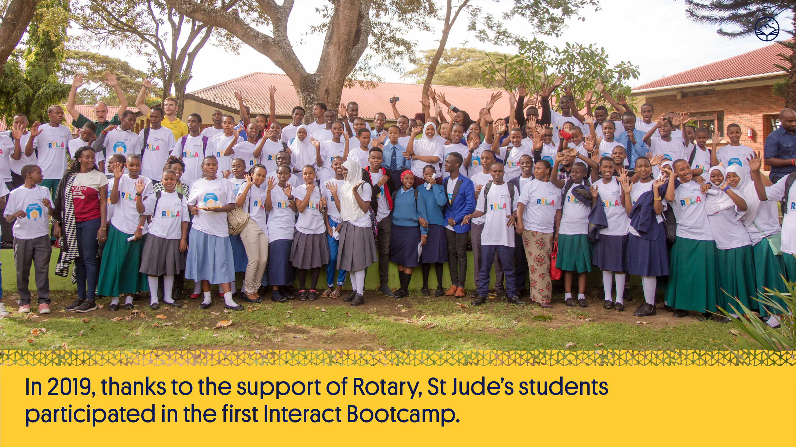
Notes:
St Jude’s Interact students and other Tanzanian students attended the Rotary’s Youth Leadership Awards Day in February 2019. 82 students, from 15 different schools across Northern Tanzania attended the day, which was modelled on a formula Rotary clubs use around the world.
Thanks to the support of the Rotary Club of Brisbane High-Rise, St Jude’s leaders also participated in the first Interact Bootcamp, with four in-depth workshops relating to different industries.
Rotary statistics show numbers of students attending club events in Tanzania are at a record high, and St Jude’s is leading the way with creating future Rotarians.

Slide 32
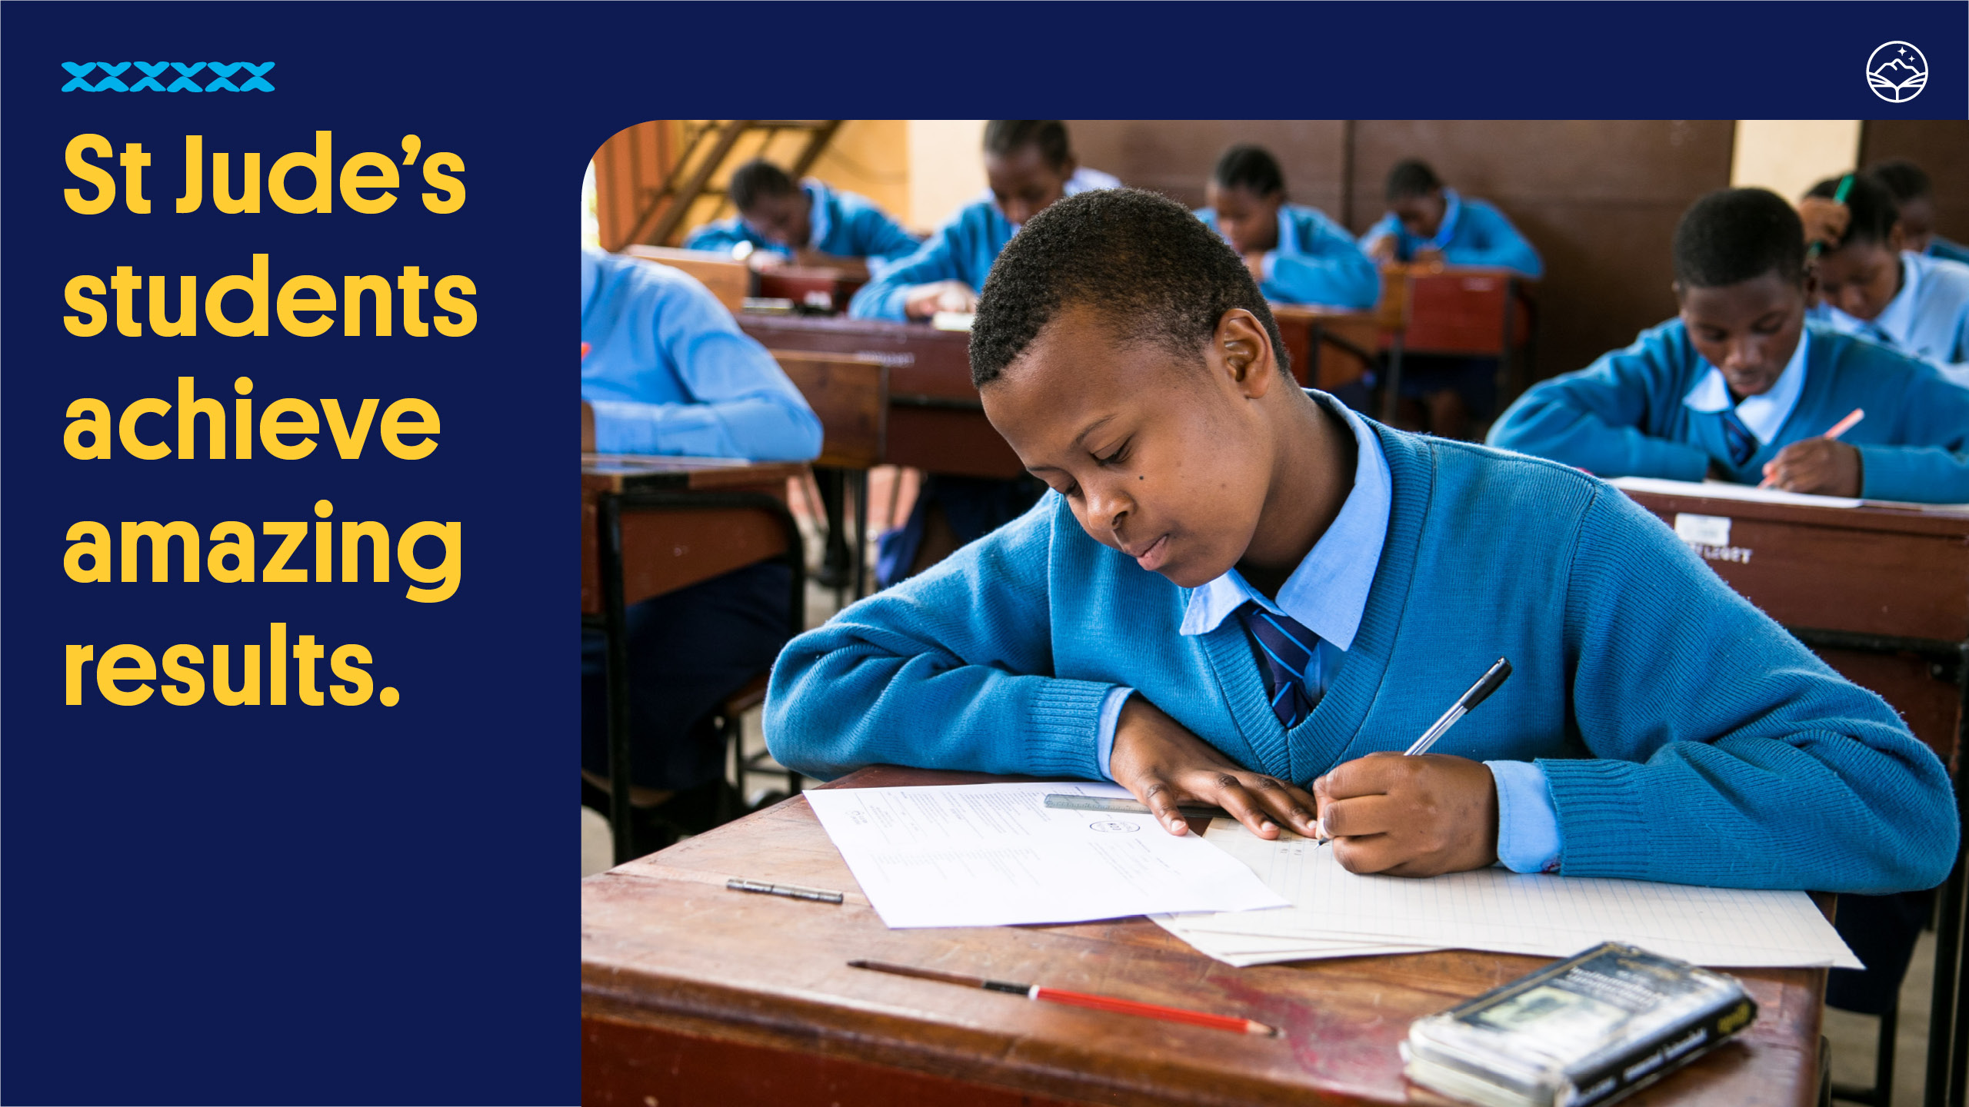
Notes:
St Jude’s students typically place in the top 5% in Tanzania.
In 2017, St Jude’s Standard 7s placed in the top 1% of all students in Tanzania and Form 6 students were in the top 1% in the country for physics.
In 2018 all of our Form 2 students achieved the highest grade and one of our students was the first ranked boy in all of Tanzania!

Slide 33
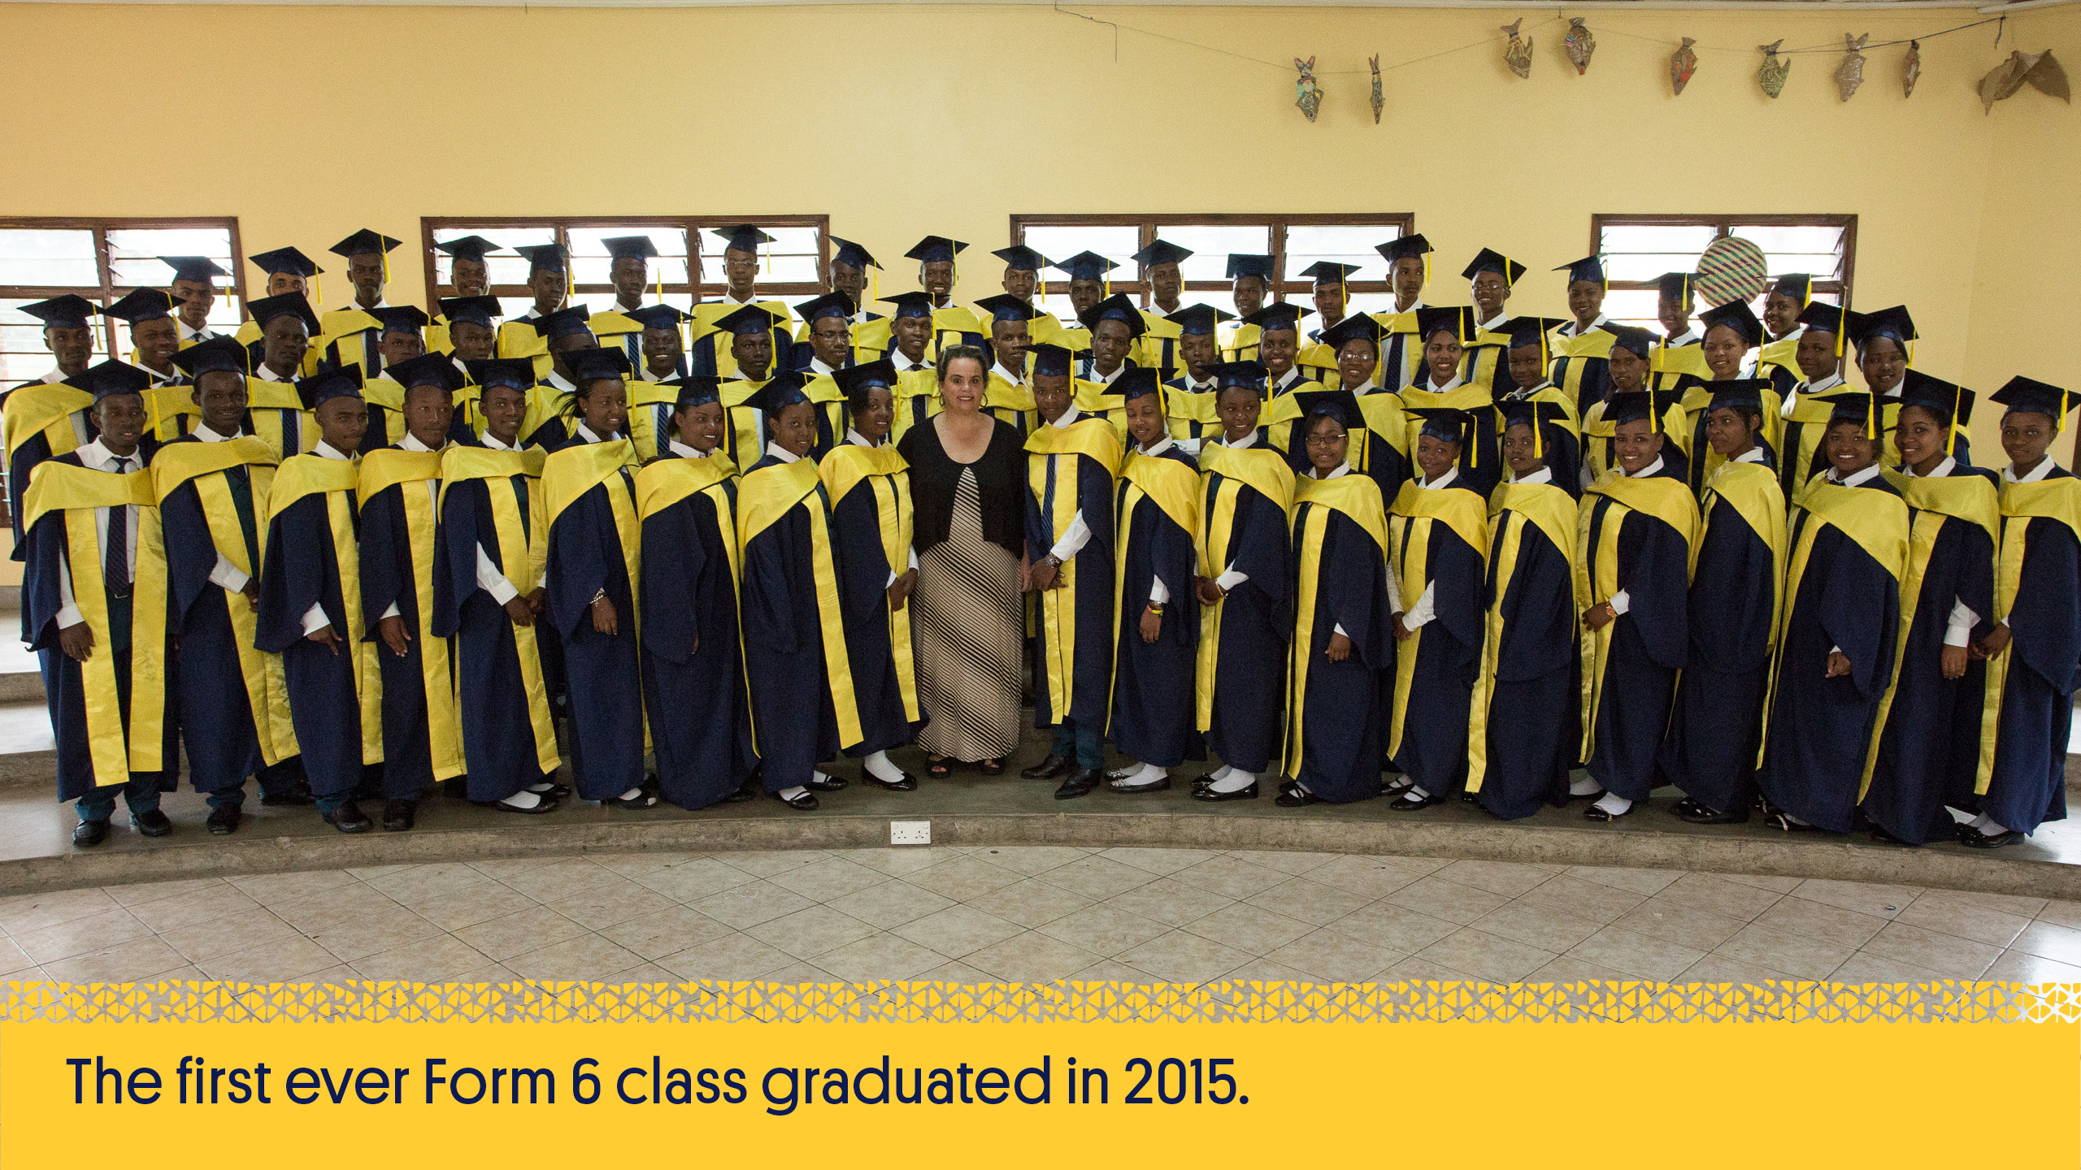
Notes:
The first ever Form 6 class, graduating in 2015, achieved a 100% pass rate, with more than 50% achieving a Distinction average.
Having successfully completed their schooling through to Form 6 makes them in the minority amongst their peers.

Slide 34
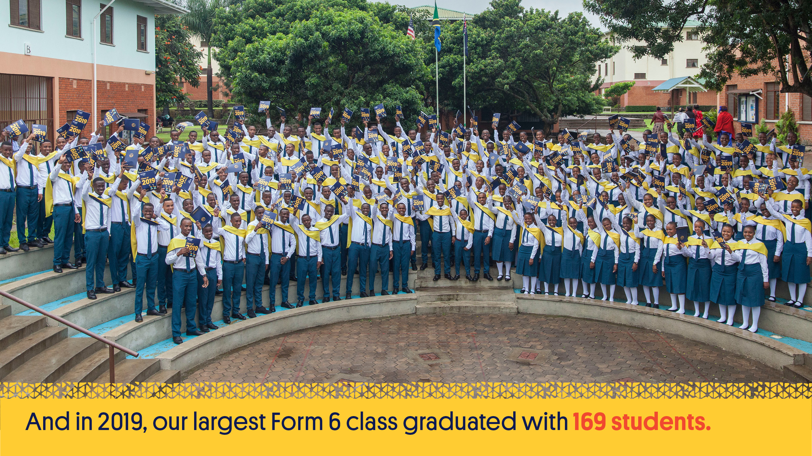
Notes:
The class of 2019 ranked 1st in Advance Mathematics in Tanzania which is a huge achievement for these students. Overall the class placed St Jude’s 4th in the Region and 65th in the Country.

Slide 35

Notes:
The first year out of school, for those who choose to participate, can be spent giving back to the local community; this is followed by higher education. Both the Community Service Year and the Tertiary Program are run by the Beyond St Jude’s team at The School of St Jude.
83% of students in the 2019 graduating class elected to participate as a way of giving back to their communities.

Slide 36
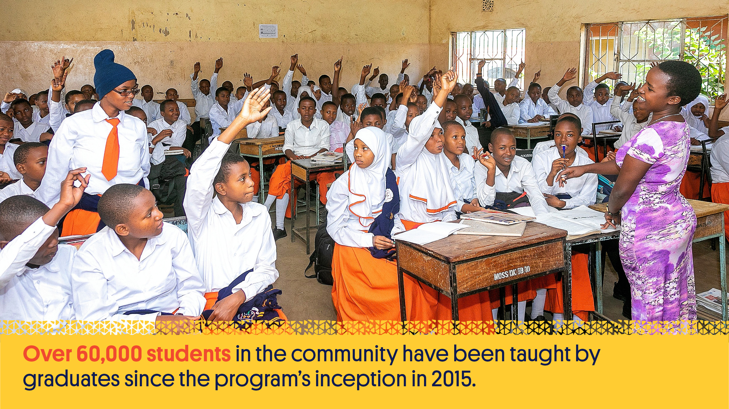
Notes:
Through the Community Service Year program, graduates contribute to their communities, volunteering as much-needed teachers in the under-resourced, under-staffed government schools, sharing the knowledge they gained from their St Jude’s education. Over 60,000 students in the community have been taught by graduates since the program’s inception in 2015.

Slide 37
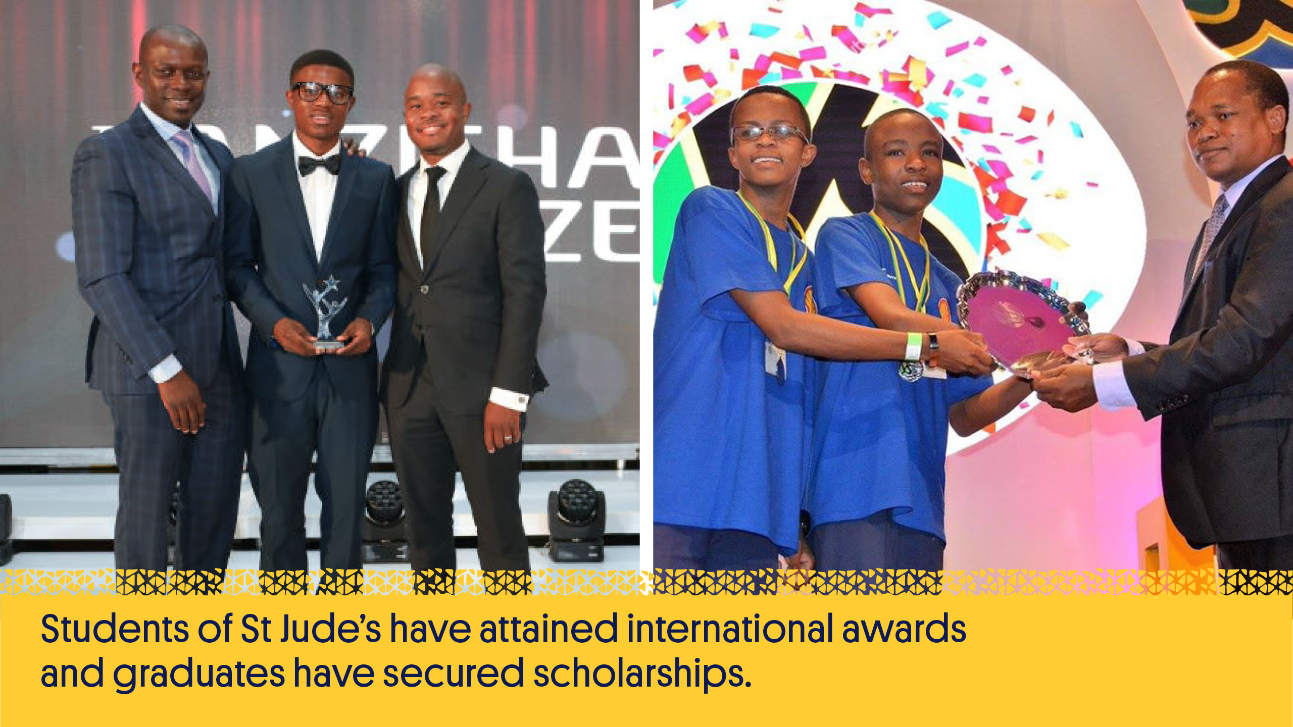
Notes:
Students of St Jude’s have attained international awards and graduates have secured scholarships to universities all over the world with some currently studying in the United States, Uganda, Russia, Rwanda, Kenya, Mauritius and Zimbabwe. Graduates not securing scholarships offered by international universities are supported through higher education within East Africa. The Beyond St Jude’s program is currently supporting over 196 scholars to do this.

Slide 38
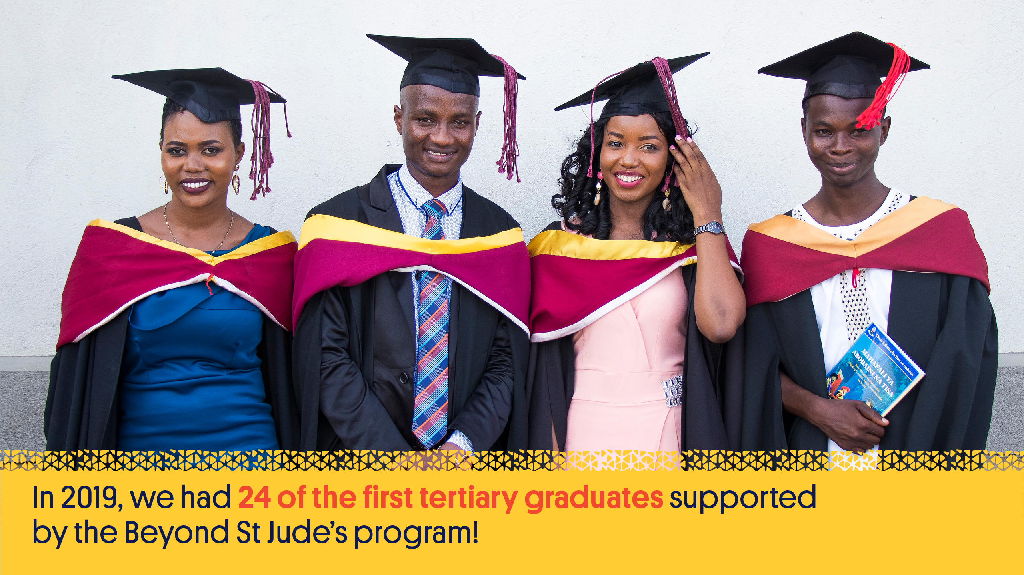
Notes:
The St Jude’s scholars are now pursuing a wide variety of degrees since completing their community service, ranging from Medicine to Agriculture as part of the Beyond St Jude’s program. And in 2019, we had 24 of the first tertiary graduates supported by the Beyond St Jude’s program, completing their educational journeys at universities across Dar Es Salaam, Arusha and Morogoro.

Slide 39
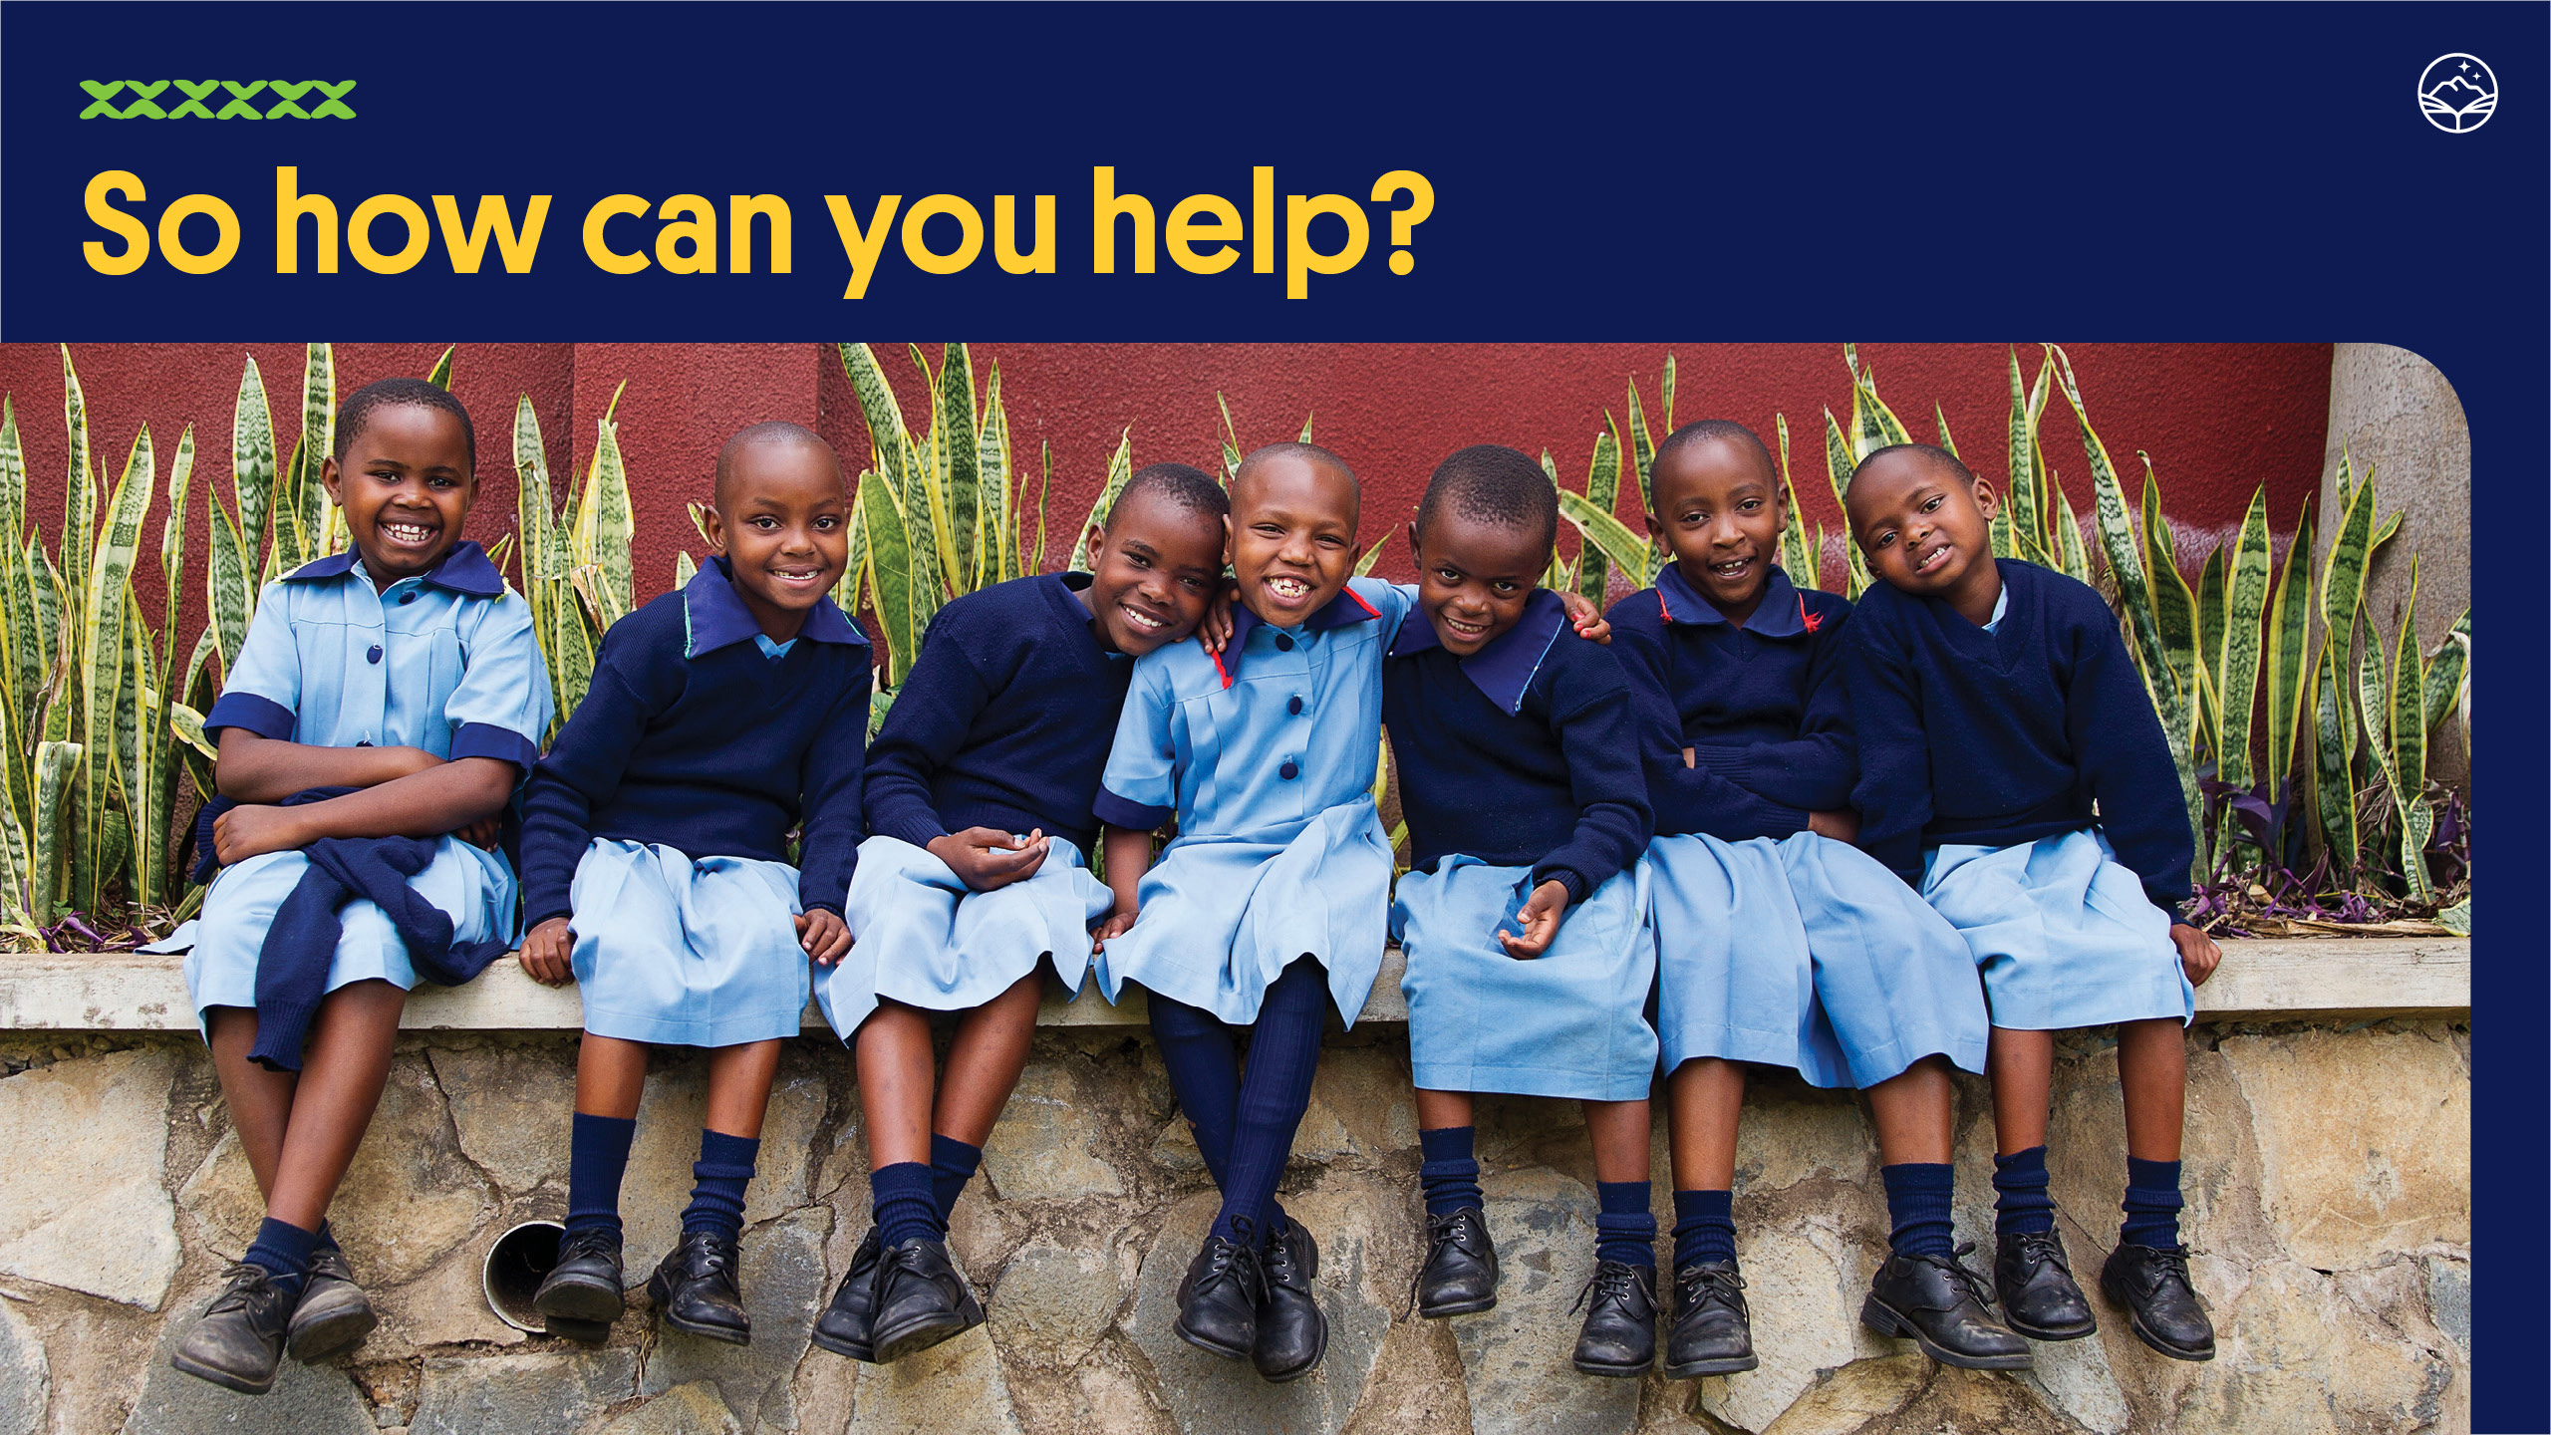
Notes:
The School of St Jude is dependent on the generosity of others. There are many ways that you can help ensure they can continue to provide an exceptional education and a higher standard of living for their students and families.

Slide 40

Notes:
St Jude’s has a range of sponsorship packages, from sponsoring one student’s entire academic scholarship to covering the costs of half or part of it.
Most importantly, all of the students attend on full scholarships which pays for their teachers, books, resources, transport, uniforms, meals and everything else an ambitious young person needs to thrive.

Slide 41

Notes:
Make a general donation of any amount which will help to cover the school’s ongoing costs, including filling the gaps in any scholarships that aren’t fully sponsored or new students who are waiting to secure sponsors.

Slide 42
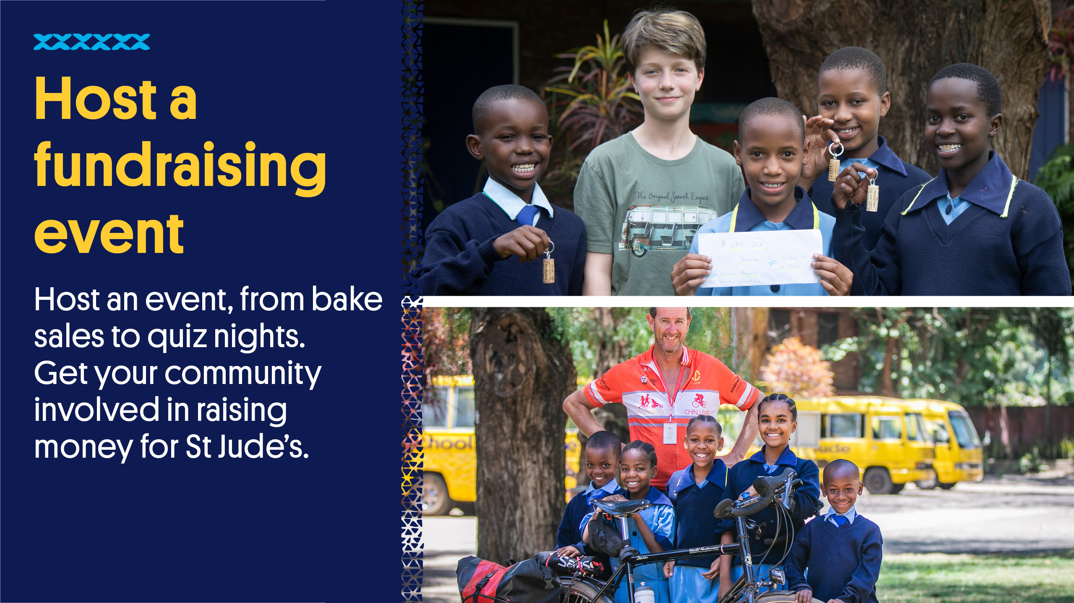
Notes:
Download a fundraising kit from the website and receive support from the Donor Relations team in your efforts.

Slide 43
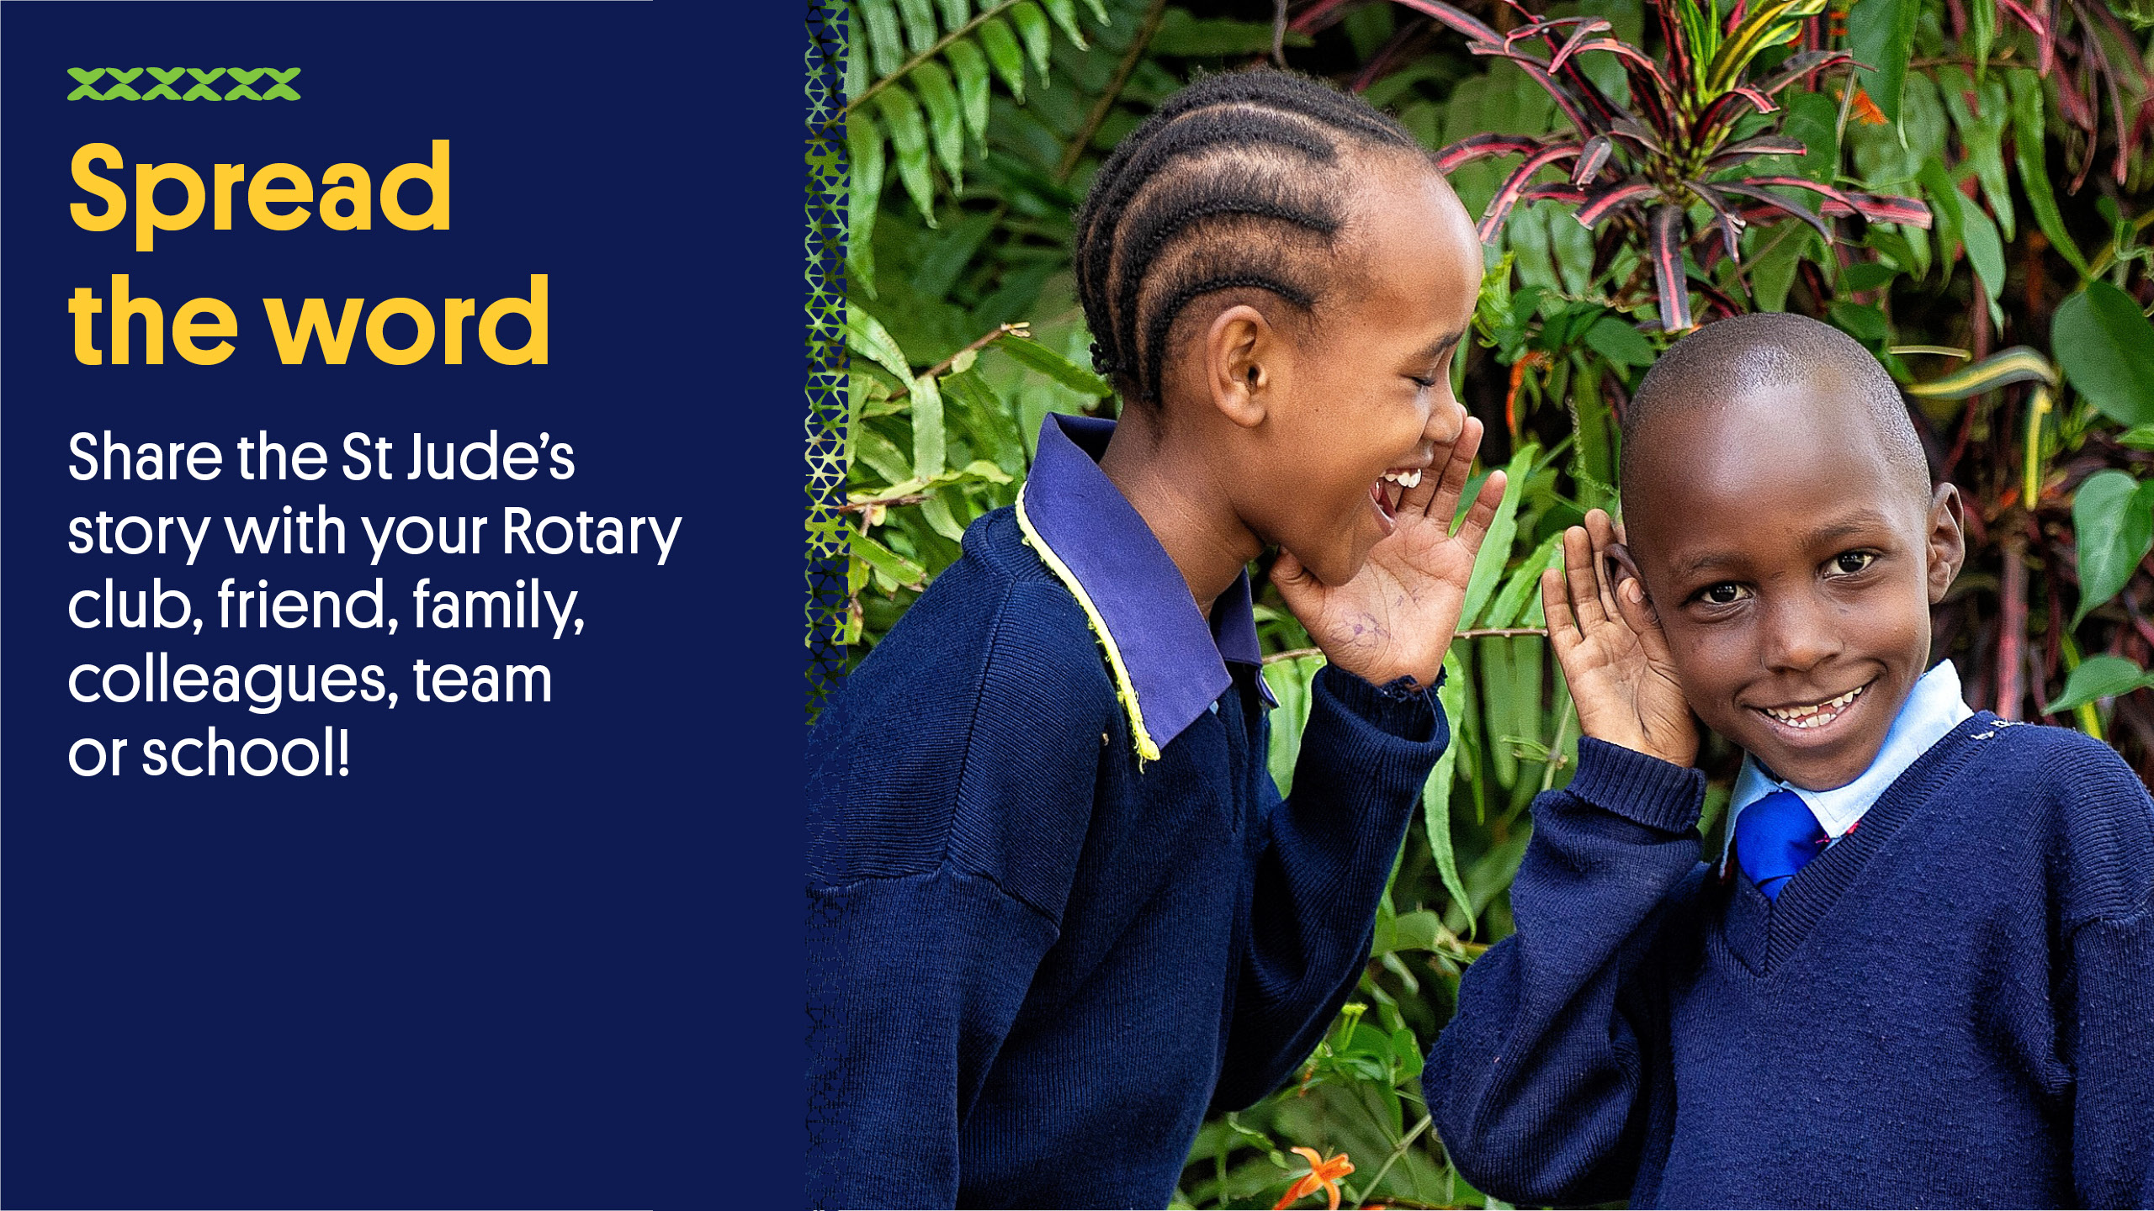
Notes:
Follow us and share the St Jude’s story through Facebook, Instagram, Youtube, LinkedIn and Twitter.

Slide 44
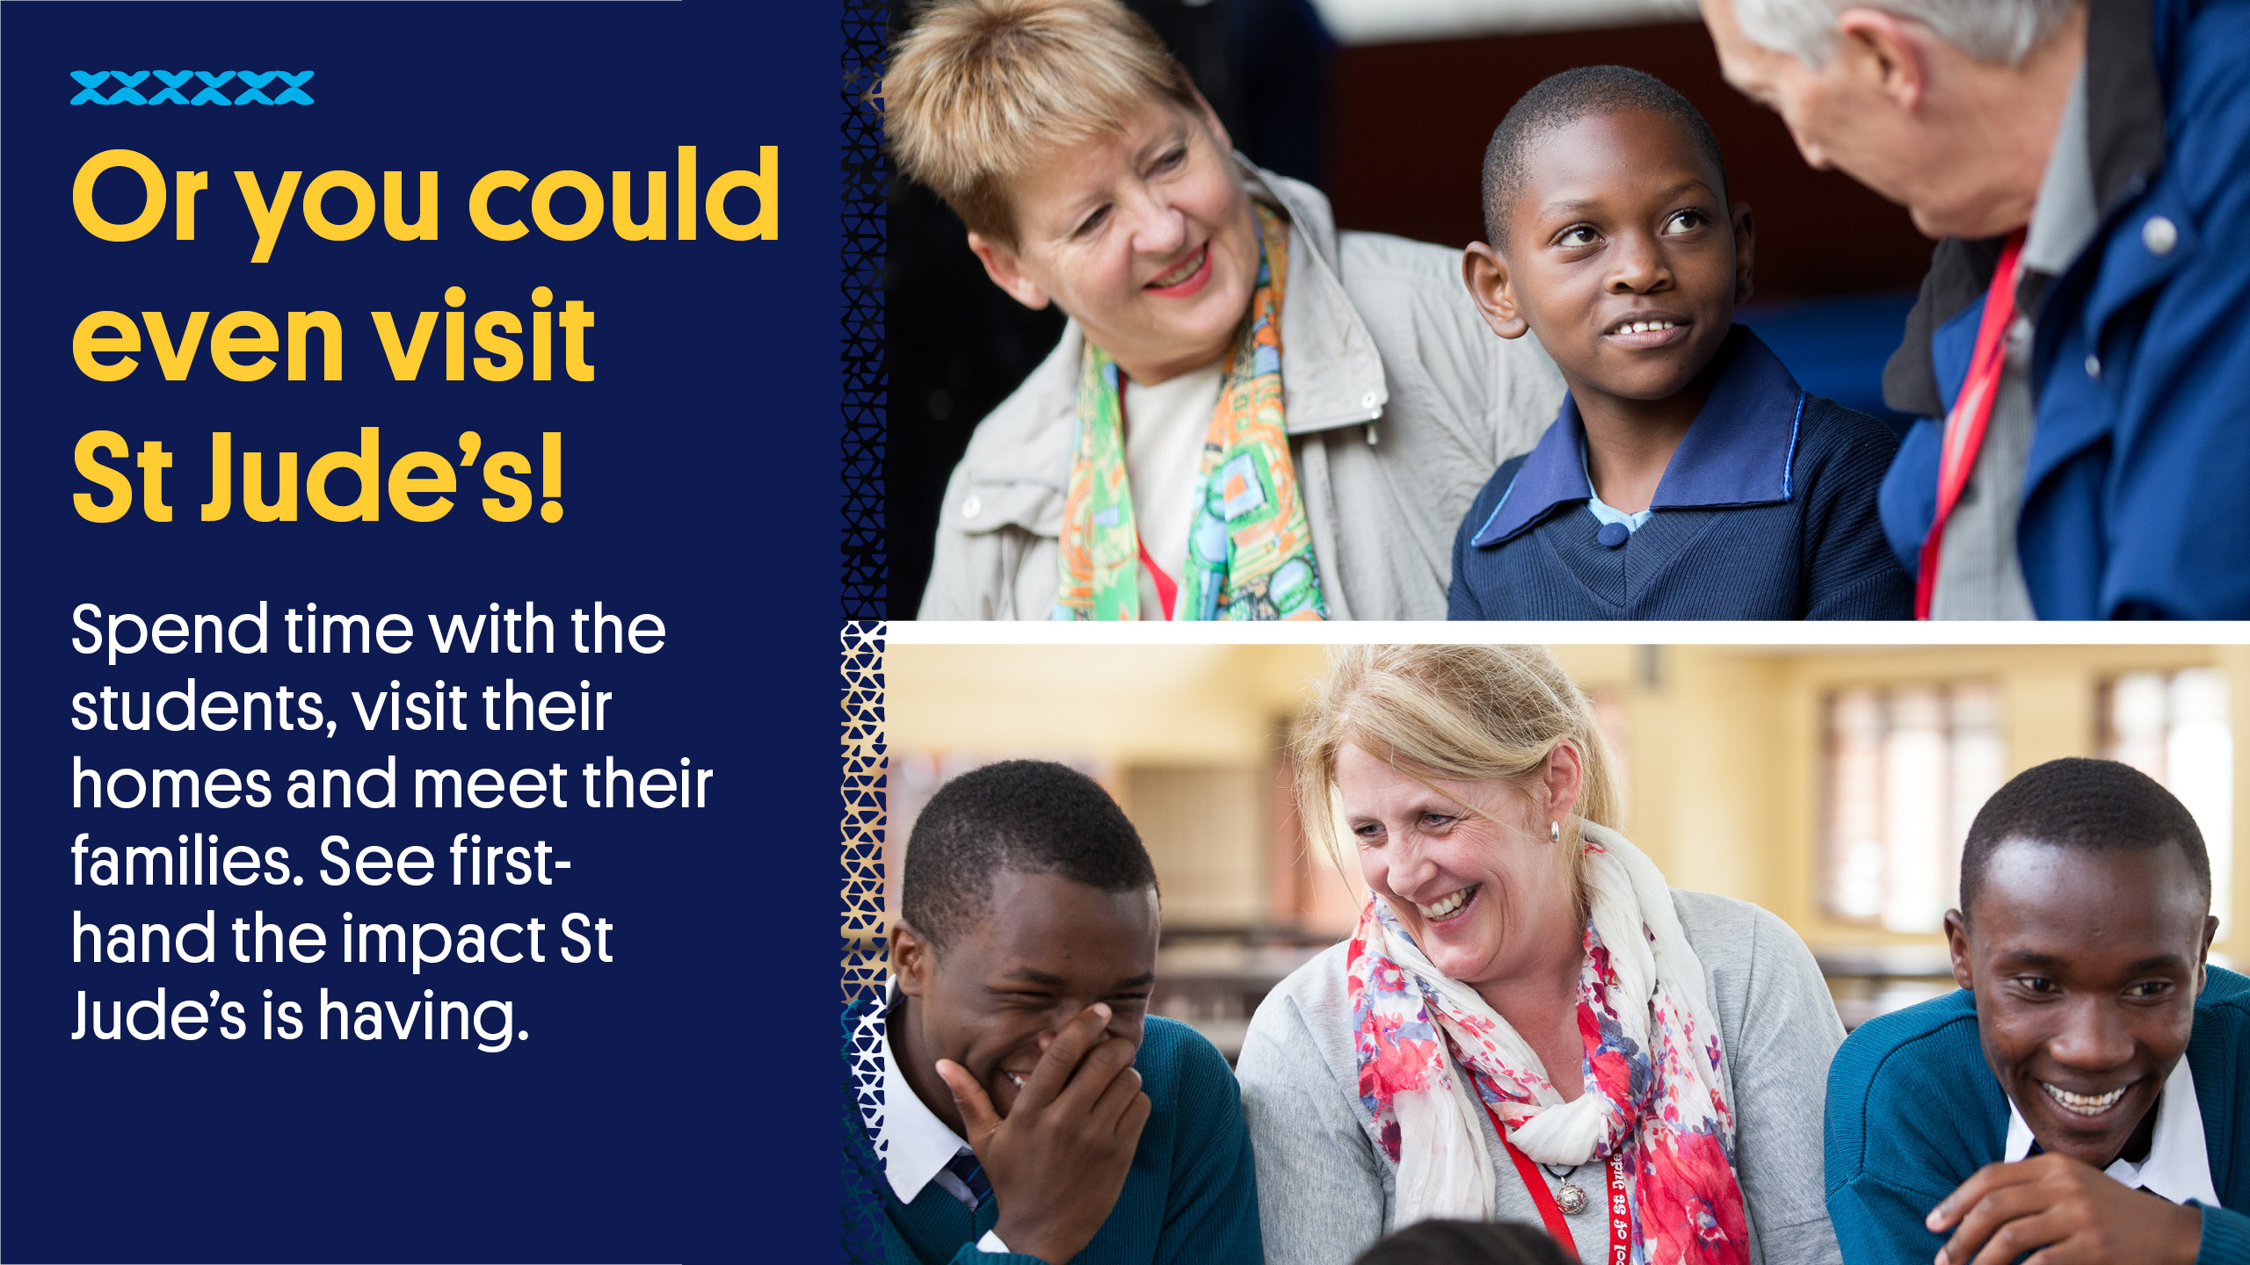
Notes:
There is lots more to see and do in Tanzania. Enjoy numerous national parks, including the world-famous Serengeti, filled with African wildlife. Experience the rich Maasai culture or attempt to scale Mount Kilimanjaro, Africa’s highest peak!
Make a visit at the same time and see for yourself how St Jude’s is changing lives by fighting poverty through education.

Slide 45


