Slide 1


Slide 2
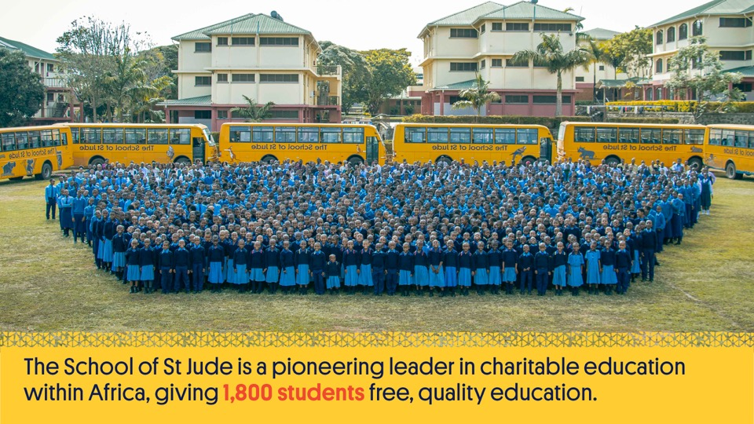
Notes:
The School of St Jude is a pioneering leader in charitable education within Africa. We provide 1,800 students with free, quality education; 100’s of graduates with access to higher education; and more than 10,000 government school students with volunteer teachers each year.

Slide 3

Notes:
Our mission is to give bright, poor Tanzanian students a free, quality education so they can lead their family, community and country with respect, responsibility, honesty and kindness to growth and prosperity.
Our school strives for academic and moral excellence; we encourage students to do more than just succeed. We empower them to become community-focused leaders who challenge the status quo and find solutions for to assist the 45 million Tanzanians living in poverty.
At St Jude’s, we create a holistic environment that promotes the development of a well-rounded person; graduates who have fulfilled their academic potential as well as exhibiting respect, responsibility, honesty and kindness; young leaders who can think, reason and, above all, share this ethos with their community.

Slide 4
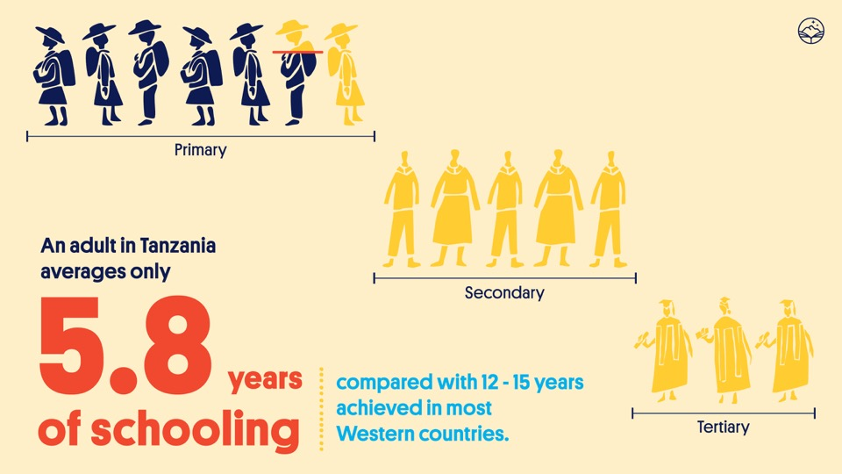
Notes:
An adult in Tanzania will have averaged less than six years of schooling compared with the 12-15 years achieved by people in most Western countries. 74% of Tanzanian students not enrolled in secondary school and 97% not enrolled in higher education.

Slide 5
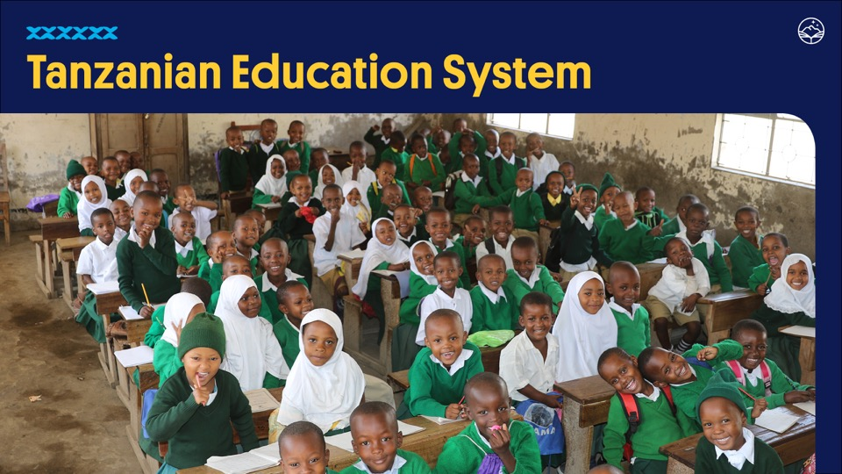
Notes:
Despite 87% of primary school aged Tanzanian children (aged 7-13) enrolling in school, the under-resourced and under-staffed education system in Tanzania means that the majority of primary school students will not pass their national primary leavers exam and won’t be eligible to continue their education. Only 3% will end up making it through to complete a tertiary education.

Slide 6
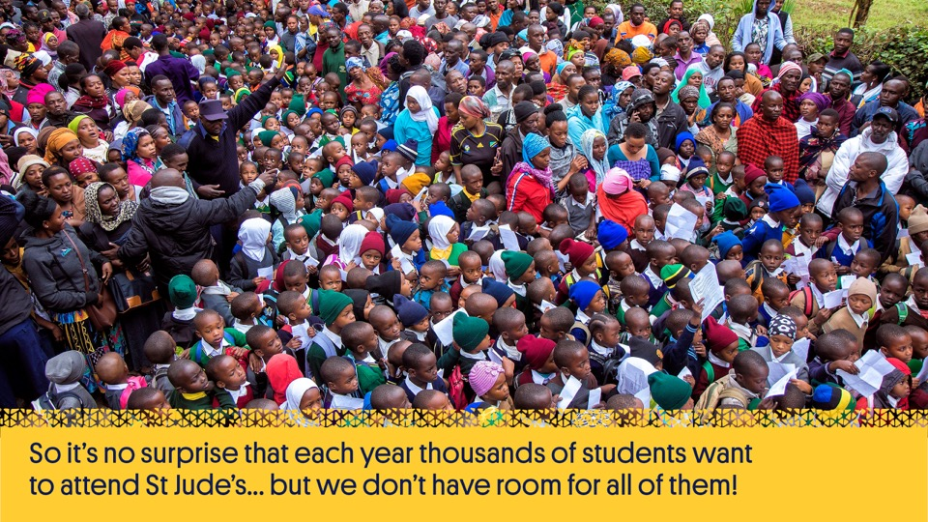
Notes:
So it’s no surprise that each year thousands of students want to attend St Jude’s but we don’t have room for all of them.

Slide 7

Notes:
Each year, over 3,000 candidates from government schools in the region are invited to attend the selection process where up to 150 places are available across Standard 1, Form 1 and Form 5.
They complete a series of tests with the youngest needing to show an enthusiasm for learning and some proficiency in Swahili, and the older students completing tests in maths, science and English.
They will have needed to have placed in the top 10% of their government school classes to be invited to the selection day.

Slide 8
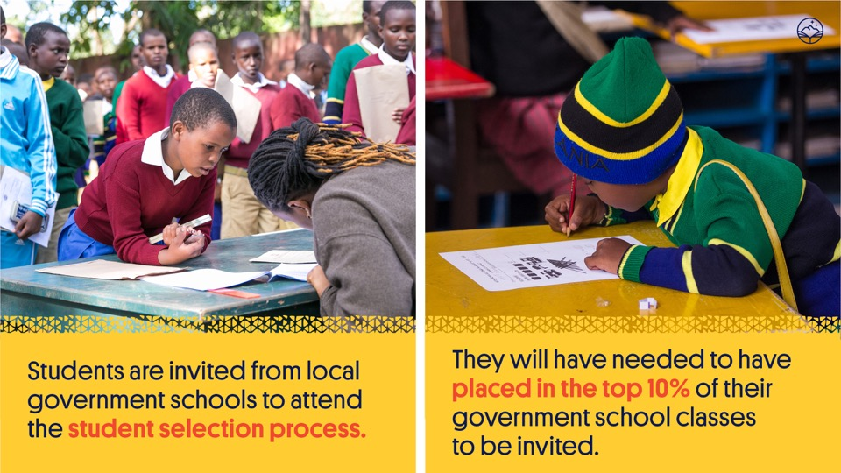

Slide 9
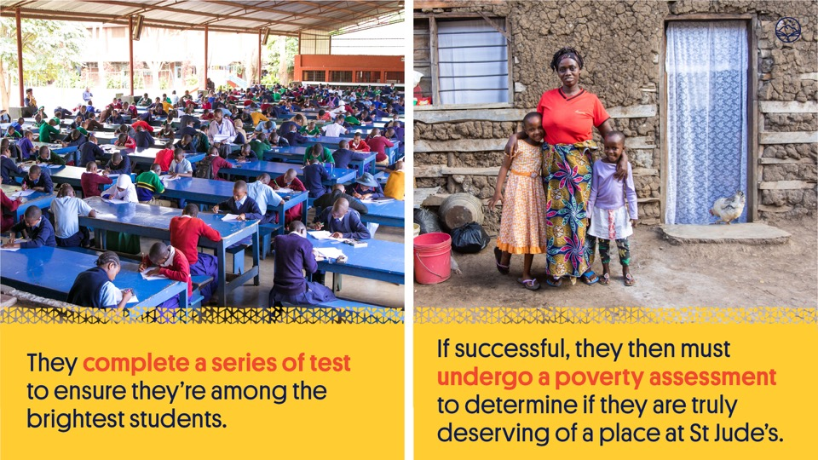

Slide 10
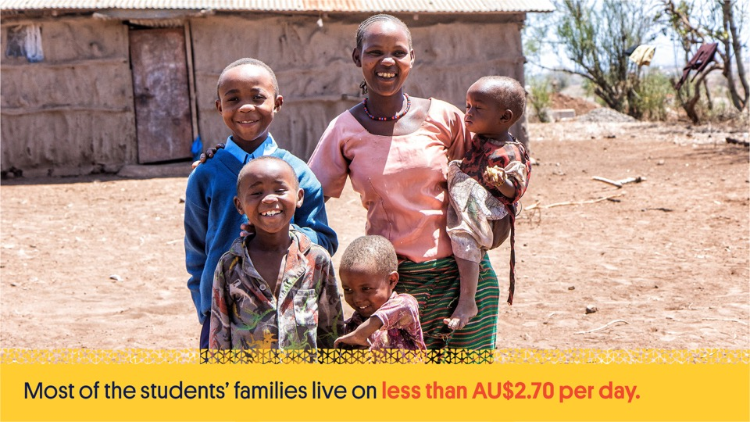
Notes:
They must also be from disadvantaged backgrounds. Every student undergoes a poverty assessment to determine their need, meaning that they are from some of the poorest families in and around the Arusha region and truly deserving of a place at St Jude’s.

Slide 11

Notes:
For the new students chosen each year, the hard work pays off on Uniform Day when they receive their brand new shirts, trousers, ties, socks, shoes and dresses. For many of them it’s the first time they’ve ever owned a new item of clothing!

Slide 12


Slide 13
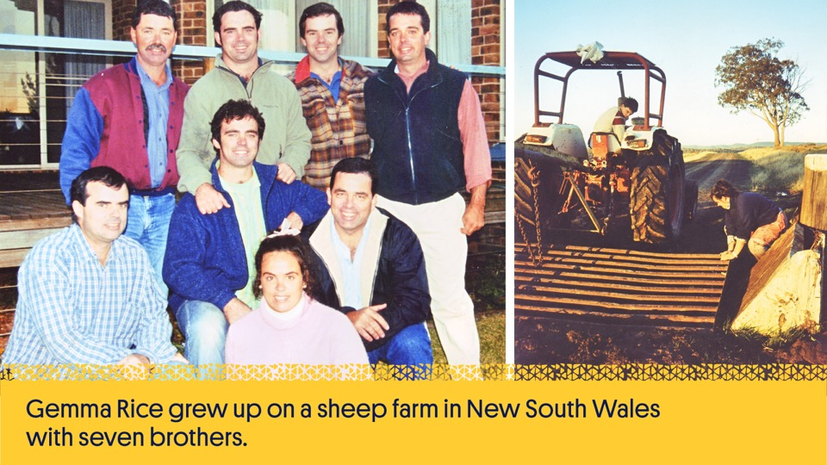
Notes:
Gemma Rice grew up on a sheep farm in northern New South Wales with seven brothers.
After finishing high school she moved to Melbourne where she completed a Science Degree (majoring in Genetics and Biochemistry).
She then went on to complete her Honours in Science before also earning a Diploma of Education.

Slide 14
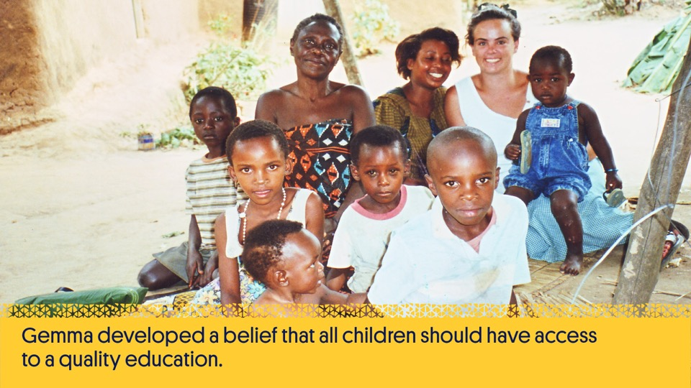
Notes:
When she was 22, Gemma travelled to Uganda to teach. There she developed her belief that all children should have access to a quality education, the key to breaking the intergenerational poverty cycle, and be able to live a life rich with knowledge, love, compassion and opportunity.

Slide 15
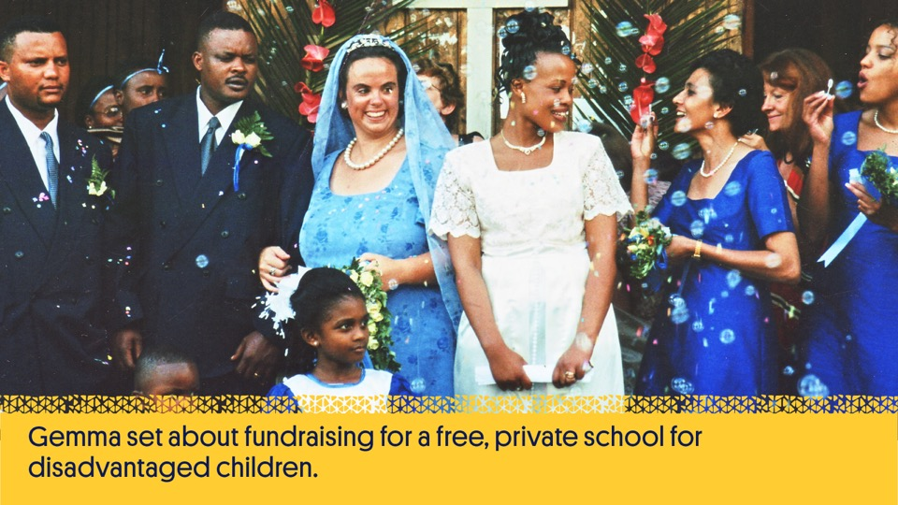
Notes:
After falling in love with and marrying Richard Sisia, a Tanzanian safari guide, Gemma decided to set up her school in Moshono, Arusha on a plot of land donated by Richard’s father, who believed she could make her vision a reality right there in his village.

Slide 16
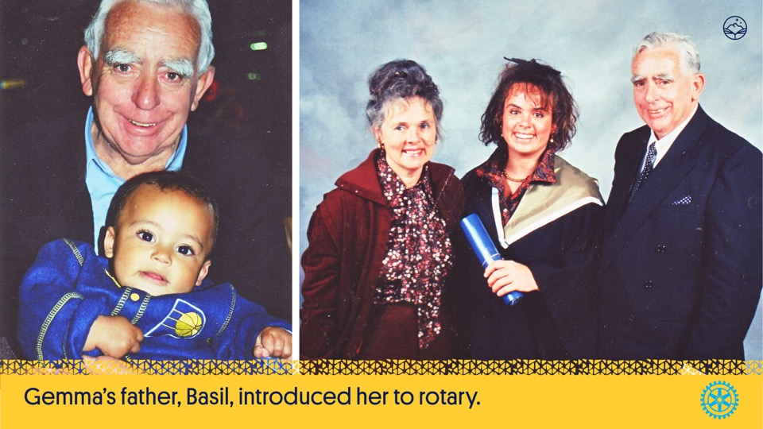
Notes:
After Gemma’s father, Basil, introduced her to Rotary she was given the opportunity to speak to her local Rotary club in her hometown of Armidale, New South Wales.
With the help of the Armidale, Tamworth and Inverell Rotary and Inner Wheel clubs, Gemma was able to raise $20,000 to get the School started.

Slide 17
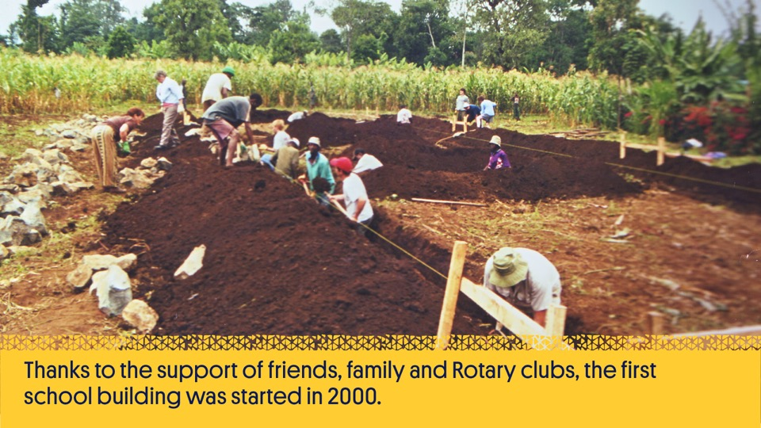
Notes:
With her first donation of just $10 from a friend, Gemma set about fundraising and began to create a free, private school for disadvantaged children.
Thanks to the support of friends, family and Rotary clubs, the first school building was started in 2000.
The Armidale Central Rotary Club organised a team of a dozen volunteers to travel to Arusha and help build the first six classrooms. A team then came from Gosford North Rotary Club and helped to build the second classroom block.

Slide 18
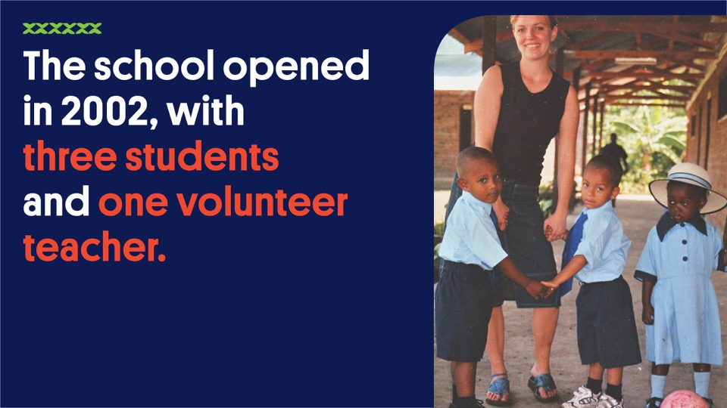
Notes:
Gemma chose the school’s name knowing that to try and start a school with a single $10 donation was surely a hopeless cause and that to make it happen, she would need all the help she could get – including from her old friend St Jude, the patron saint of hopeless and impossible causes. In 2002 when the school gates opened, she had only secured sponsors for three children, so that’s where they started.

Slide 19
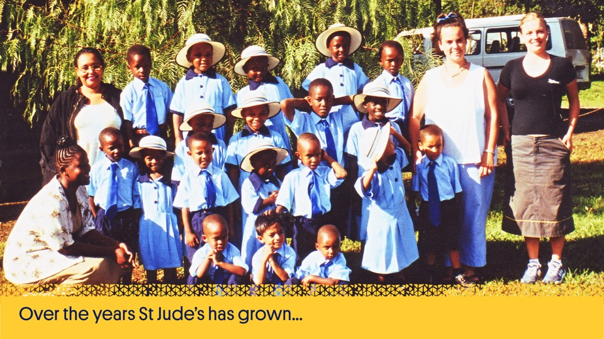
Notes:
But she worked hard to secure more sponsorships so that she could bring the opportunity to more students.

Slide 20
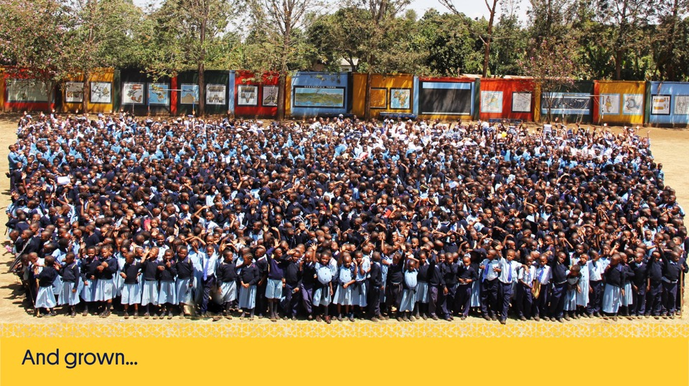

Slide 21
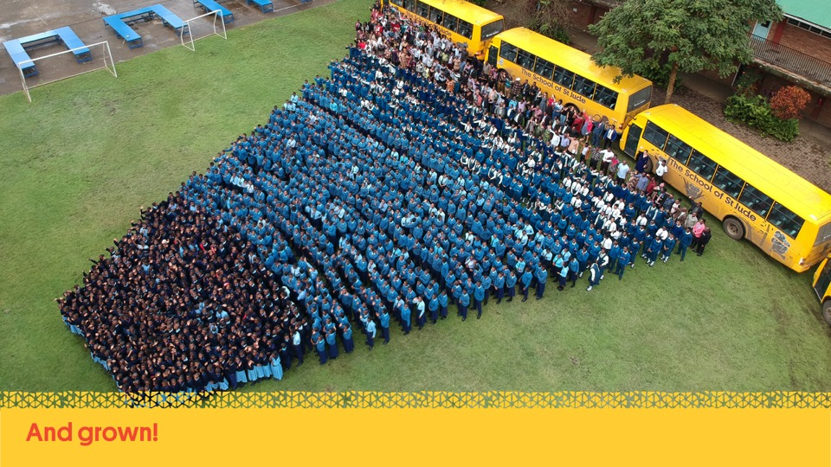

Slide 22
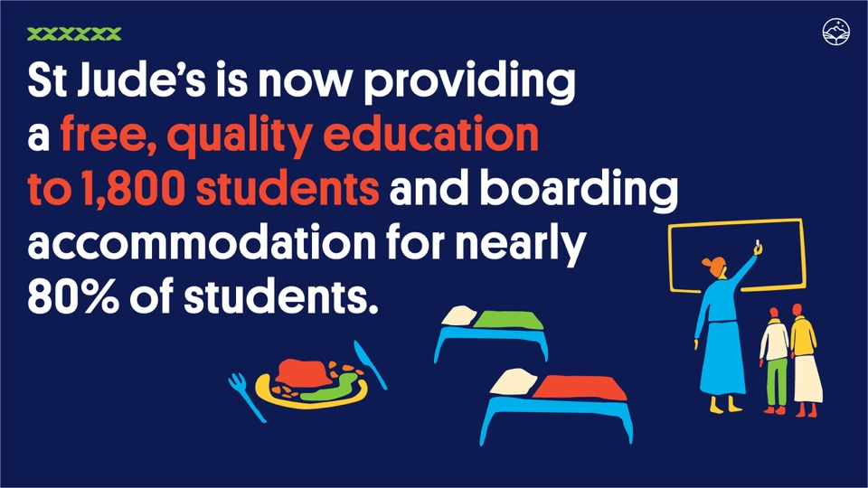
Notes:
In 2021, St Jude’s is providing free, quality education to 1,800 students and boarding accommodation for nearly 80% of our student population as well as providing more than 1 million meals each year for its students and staff! The school employs nearly 300 local staff, including academic and business leaders and all of the teachers are Tanzanian.

Slide 23
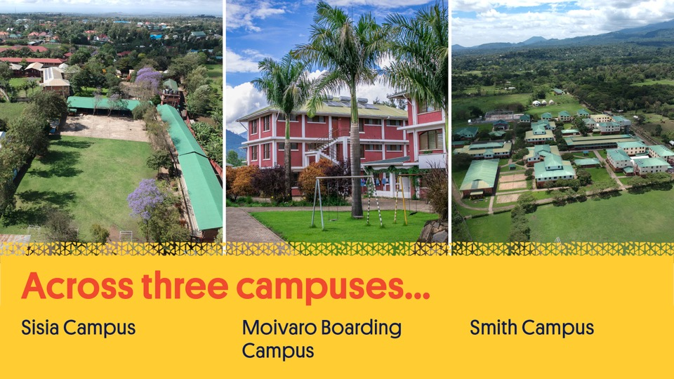
Notes:
St Jude’s is spread across three campuses;
Sisia Campus - educating Standard 1 to Standard 7 and home to our business administration office. It is also where we opened St Jude’s Girls’ Secondary School, providing education for girls from Form 1 to Form 4.
Moivaro Boarding Campus – providing boarding to Standard 6 & 7 throughout the school week and also boarding for the new girls’ secondary school students
Smith Secondary Campus - educating O Level Boys and all A Level students’ as well as providing boarding accommodation

Slide 24

Notes:
In January 2020, St Jude’s took a bold next step and opened a new secondary school for girls – St Jude’s Girls’ Secondary School, that will educate up to 600 girls from Form 1 to Form 4.
Opening a girls’ secondary school enables us to increase our intake of females into secondary. We are stacking the odds in their favour by supporting them to attend and remain enrolled in school.
We currently have approximately 150 students graduating each year. The opening of the girls’ school means that, at full capacity, we’ll have 240 Form 6 students graduating per year by 2025. This means more female students will graduate from high school and enter into higher education. More women will join the workforce, and we will nurture more educated female role models and mentors for future generations.

Slide 25
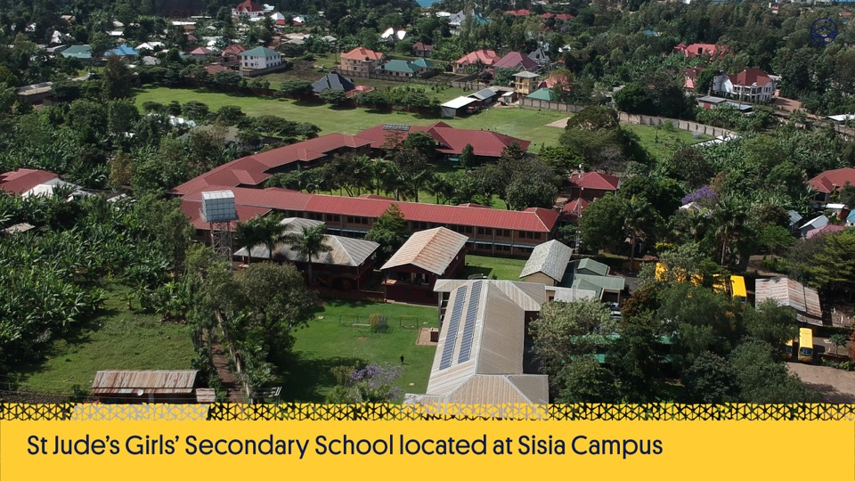

Slide 26
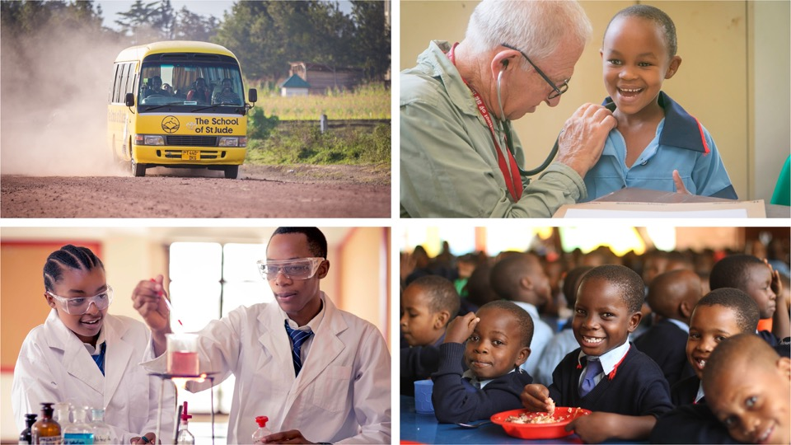
Notes:
The students are taught an extended national curriculum and have access to science and computer labs and libraries. The school prioritises nutrition with nourishing daily meals and clean water, optimises health with checks by international medical volunteers and provides transport to maximise attendance for those not yet old enough to board.

Slide 27
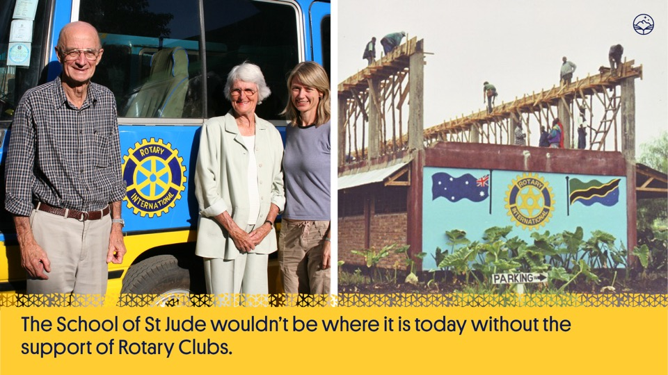
Notes:
The School of St Jude wouldn’t be where it is today without the support of Rotary Clubs.
It continues to work with Rotary and is dedicated to producing community members who hold the same values as Rotarians.
Over 19 years 283 Rotary Clubs have helped to raise over three million dollars for the school.

Slide 28

Notes:
Rotary continues to support The School of St Jude. Every year Gemma attends various Rotary District Conferences all over the world from Australia and New Zealand to America. Rotary helped build the school’s first classroom, stock their libraries, purchase buses and support the teachers. It has sponsored students and shared the St Jude’s story with thousands of others to raise awareness.

Slide 29
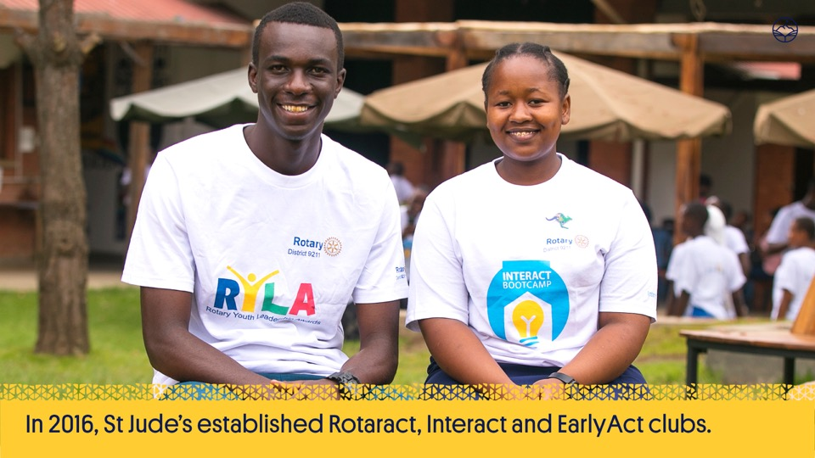
Notes:
We are proud to say that the value of Rotary has also been realised by our students.
In 2016, St Jude’s established Rotaract, Interact and EarlyAct clubs.

Slide 30
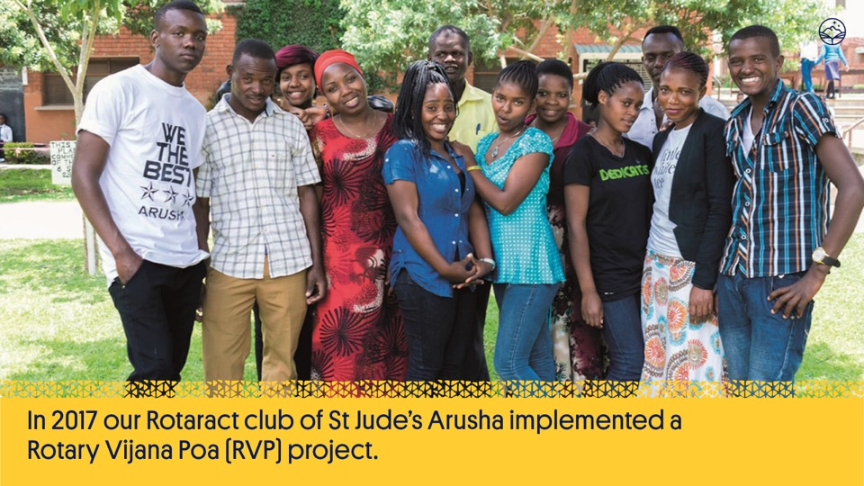
Notes:
In 2017 our Rotaract Club of St Jude’s Arusha implemented a Rotary Vijana Poa (RVP) project to help 12 individuals escape the cycle of poverty caused by youth unemployment. All participants successfully completed a 5 week training workshop with 60% gaining employment or starting their own business after.

Slide 31
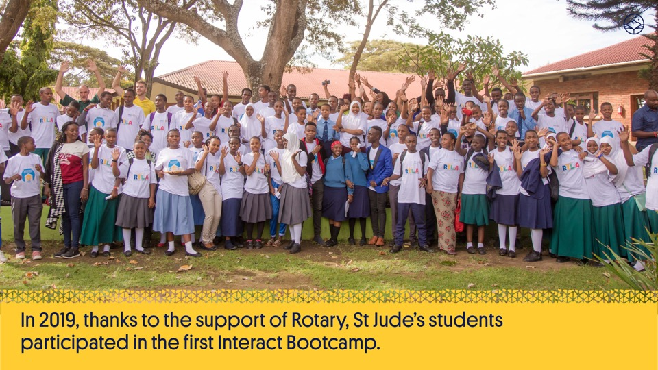
Notes:
St Jude’s Interact students and other Tanzanian students attended the Rotary’s Youth Leadership Awards Day in February 2019. 82 students, from 15 different schools across Northern Tanzania attended the day, which was modelled on a formula Rotary clubs use around the world.
Thanks to the support of the Rotary Club of Brisbane High-Rise, St Jude’s leaders also participated in the first Interact Bootcamp, with four in-depth workshops relating to different industries.
Rotary statistics show numbers of students attending club events in Tanzania are at a record high, and St Jude’s is leading the way with creating future Rotarians.

Slide 32
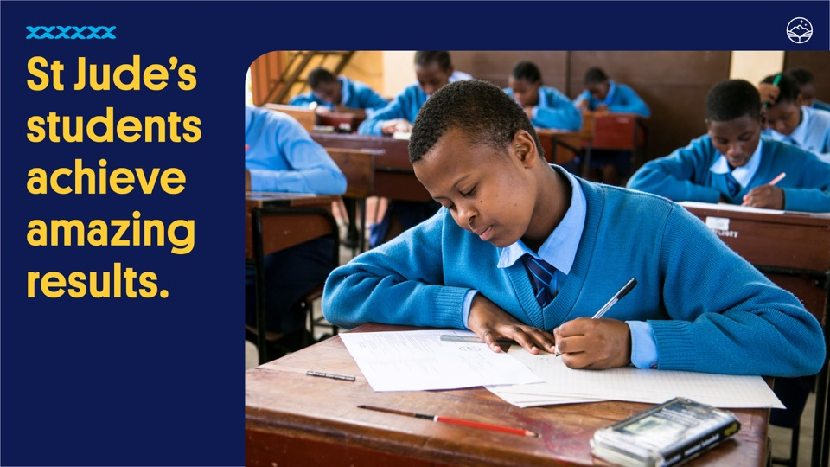
Notes:
St Jude’s students typically place in the top 5% in Tanzania.
In 2017, St Jude’s Standard 7s placed in the top 1% of all students in Tanzania and Form 6 students were in the top 1% in the country for physics.
In 2018 all of our Form 2 students achieved the highest grade and one of our students was the first ranked boy in all of Tanzania!

Slide 33
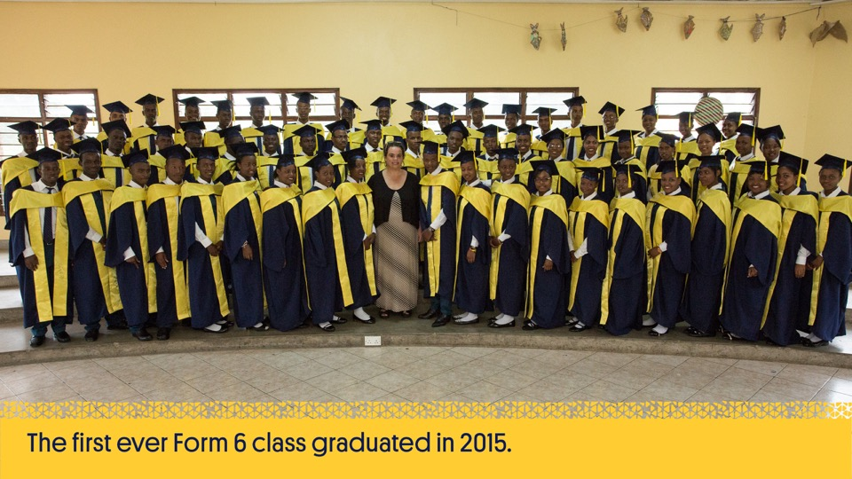
Notes:
The first ever Form 6 class, graduating in 2015, achieved a 100% pass rate, with more than 50% achieving a Distinction average.
Having successfully completed their schooling through to Form 6 makes them in the minority amongst their peers.

Slide 34
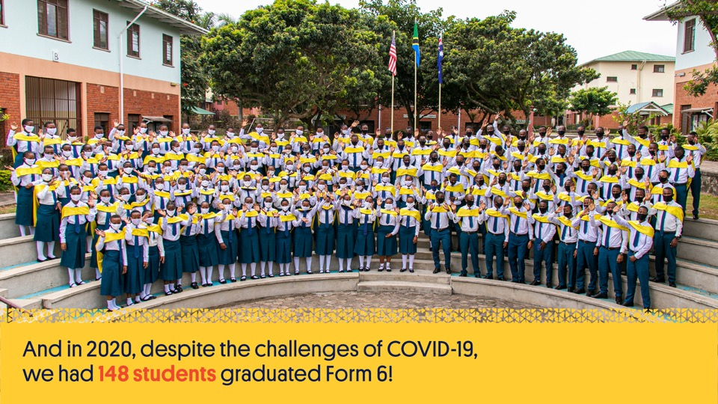
Notes:
2020 was an extremely challenging year for the school but despite it all, 148 students successfully graduated Form 6 at St Jude’s.

Slide 35

Notes:
Beyond St Jude’s is an optional, yet popular, scholarship program for our Form 6 graduates. It is comprised of two parts; the program enables our graduates to give back to their communities in an educational context as volunteers through a Community Service Year (CSY) and then provides them with the funding they need to go on to access higher education.
Over 95% of students in the 2020 graduating class elected to participate as a way of giving back to their communities.

Slide 36
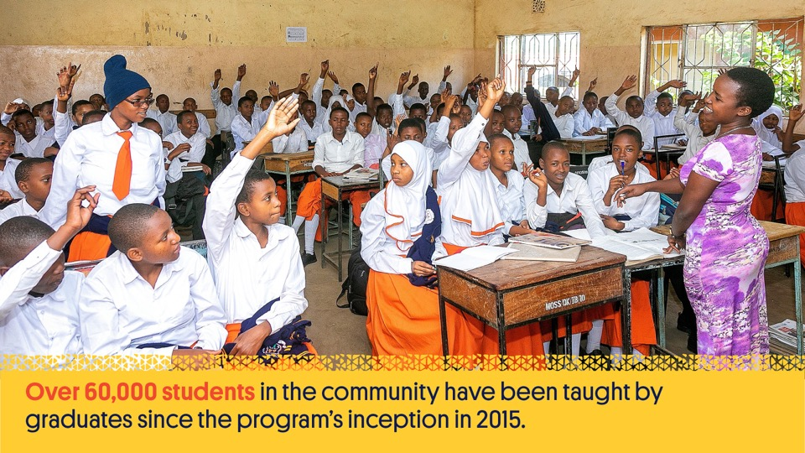
Notes:
During Form 6, students can apply to take part in the Community Service Year (CSY) in their first year out of school, to give back in appreciation for the free education they received at St Jude’s. As Community Service Year volunteers, they personify the school’s vision, sharing their gifts of knowledge and values they learned at St Jude’s by teaching in local government schools or in non-teaching placements throughout St Jude’s campuses.
The BSJ team provides year-round support to CSY participants and visit them at their CSY placement to ensure their working conditions are satisfactory.
The challenges for our graduates teaching in Tanzania's under-resourced government schools are enormous: for instance, some CSY volunteers teach classes of up to 130 students.
Since the program launched in 2015, our graduates have voluntarily taught over 80,000 students in government schools throughout Arusha and surrounding regions. Many of these students would have been without teachers in the critical disciplines of mathematics and science if it weren’t for these volunteers. Equally, the Form 6 graduates volunteering in St Jude's Head Office and around our campuses positions are valuable assets to the school, giving a unique perspective to students, employees and visitors. As well as giving back, our graduates grow in confidence as they develop their leadership skills and become positive role models for our younger students.

Slide 37
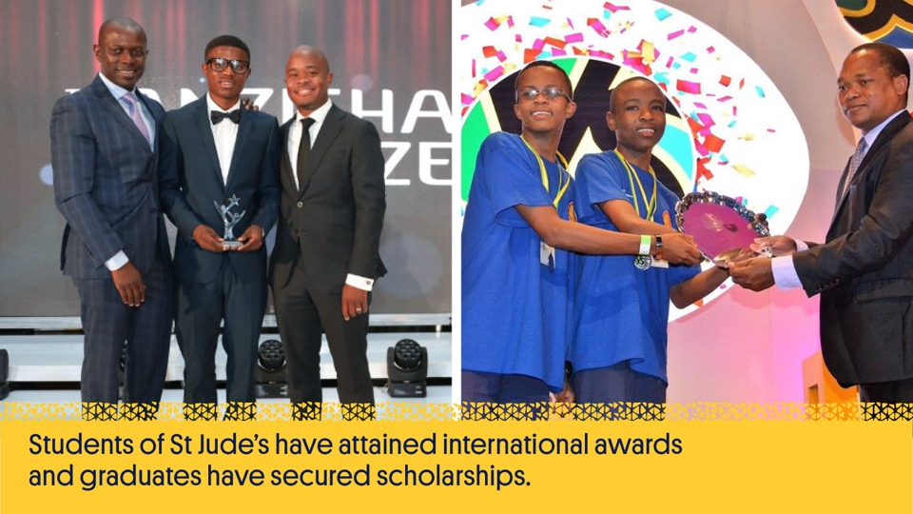
Notes:
Students of St Jude’s have attained international awards and graduates have secured scholarships to universities all over the world with some currently studying in the United States, Uganda, Russia, Rwanda, Kenya, Mauritius and Zimbabwe. Graduates not securing scholarships offered by international universities are supported through higher education within East Africa. The Beyond St Jude’s program is currently supporting over 196 scholars to do this.

Slide 38
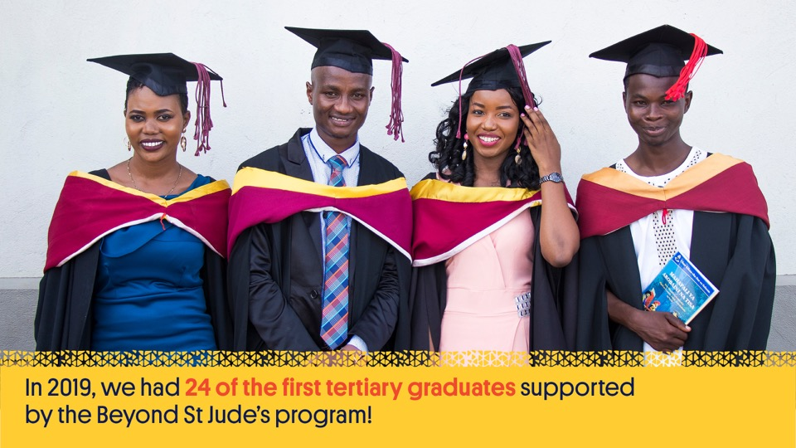
Notes:
Through the Tertiary Program, graduates are supported in their first higher education qualification; whether that be a degree, diploma or certificate course. A Beyond St Jude’s Tertiary scholarship supports students to continue on this transformative path, helping to cover tuition fees, students’ accommodation, living expenses, study materials and costs for examinations.
The BSJ team provides year-round support to Tertiary scholars and visit them at their university, to ensure their study and living conditions are satisfactory.
Many Tertiary scholars have followed study paths in fields such as health and allied sciences, business, engineering and humanities. These scholars are another step closer to becoming the next generation of leaders that will deliver a sustainable and self-determining future for the people of Tanzania.

Slide 39
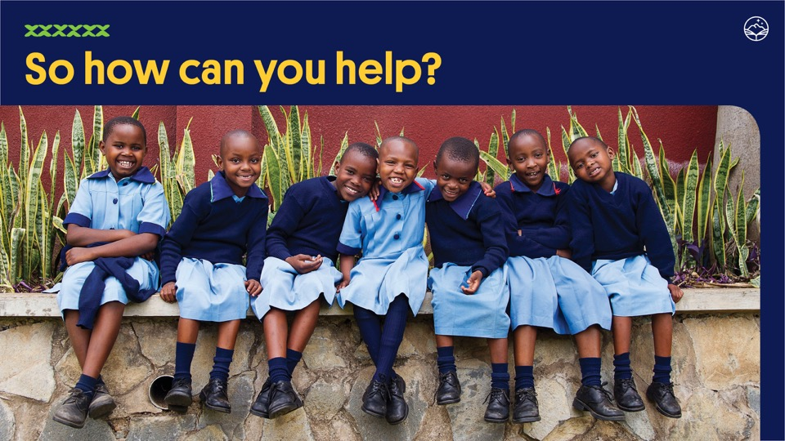
Notes:
The School of St Jude is dependent on the generosity of others. There are many ways that you can help ensure they can continue to provide an exceptional education and a higher standard of living for their students and families.

Slide 40

Notes:
St Jude’s has a range of sponsorship packages, from sponsoring one student’s entire academic scholarship to covering the costs of half or part of it.
Most importantly, all of the students attend on full scholarships which pays for their teachers, books, resources, transport, uniforms, meals and everything else an ambitious young person needs to thrive.

Slide 41

Notes:
Make a general donation of any amount which will help to cover the school’s ongoing costs, including filling the gaps in any scholarships that aren’t fully sponsored or new students who are waiting to secure sponsors.

Slide 42
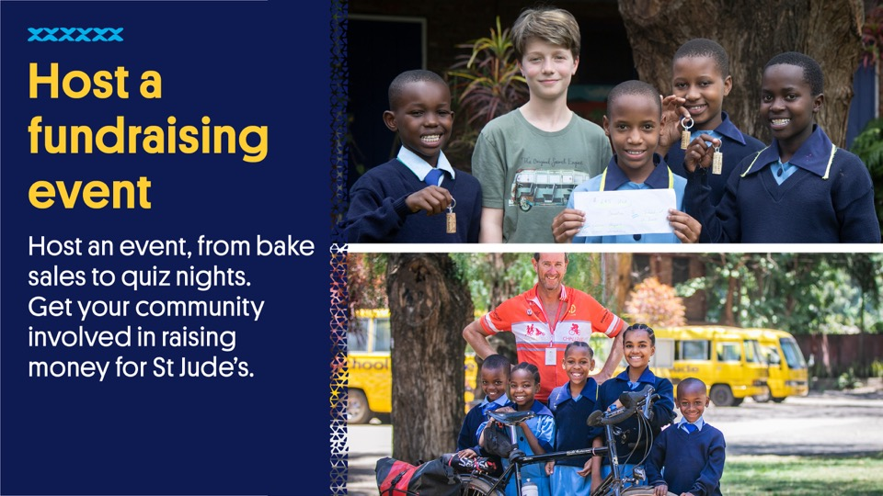
Notes:
Download a fundraising kit from the website and receive support from the Donor Relations team in your efforts.

Slide 43
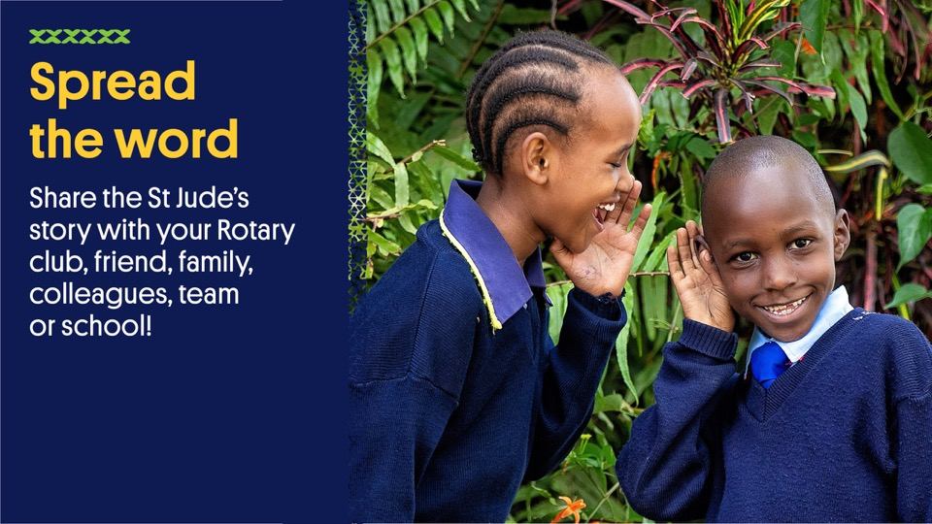
Notes:
Follow us and share the St Jude’s story through Facebook, Instagram, Youtube, LinkedIn and Twitter.

Slide 44
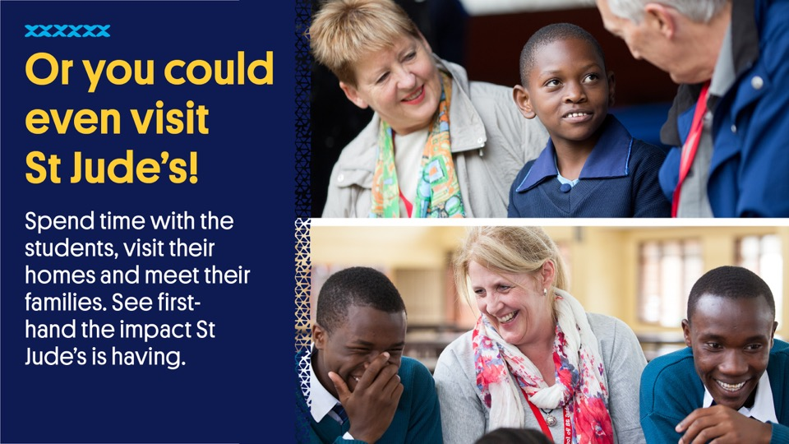
Notes:
There is lots more to see and do in Tanzania. Enjoy numerous national parks, including the world-famous Serengeti, filled with African wildlife. Experience the rich Maasai culture or attempt to scale Mount Kilimanjaro, Africa’s highest peak!
Make a visit at the same time and see for yourself how St Jude’s is changing lives by fighting poverty through education.

Slide 45


